Slide 2
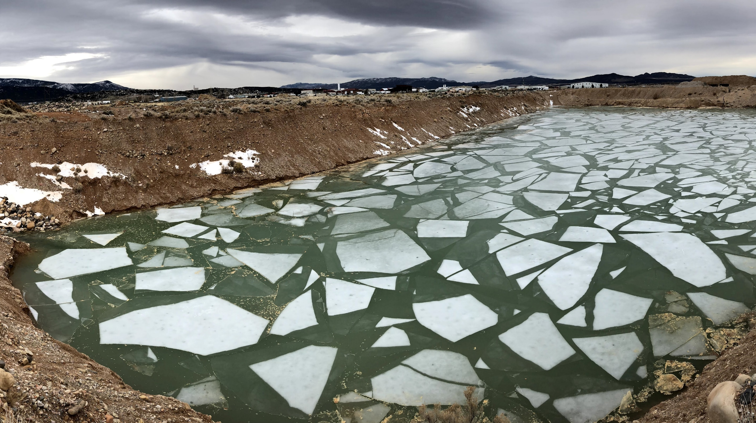

Slide 3
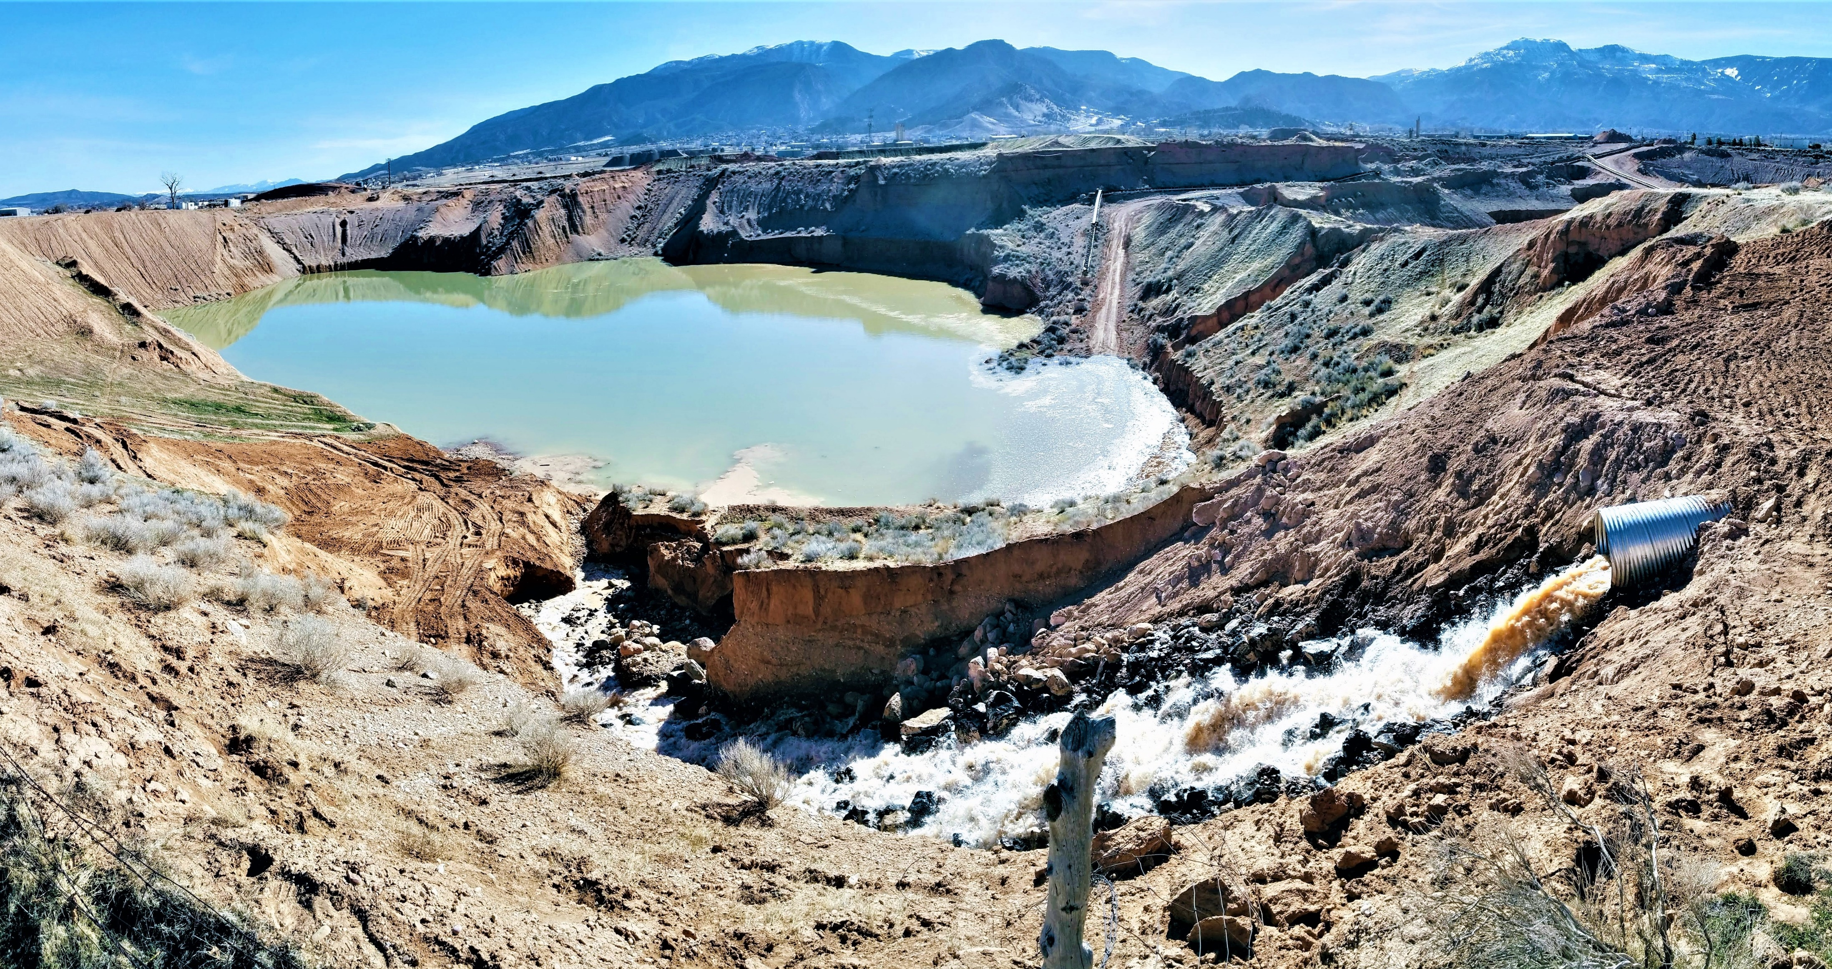

Slide 4
Notes:
Last year we obtained a grant to transition to a more efficient irrigation practice
– We have received applications to install 1,595 acres, 17,944 liner feet of Center Pivots into this new Low Elevation Spray Application (LESA). Which has been documented to save as much as 25%. I was placed on the Legislative organized Ag Optimization Committee last year and am intrigued and energized with the new technologies that are available to help preserve and protect our heritage and this natural resource.

Slide 5
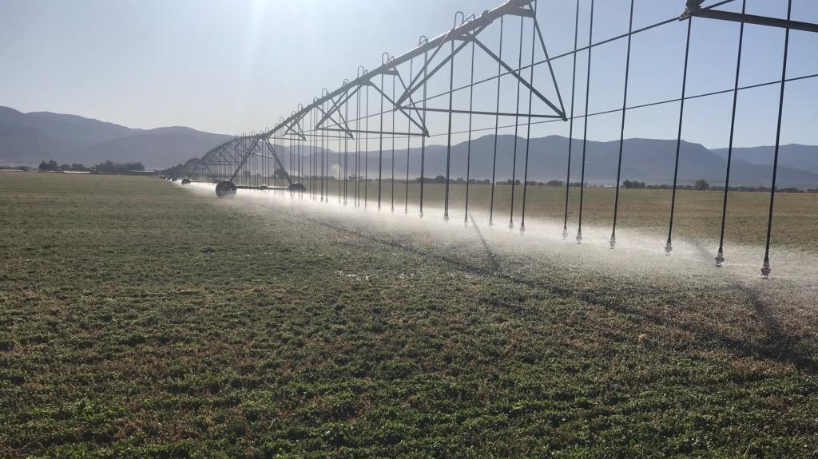

Slide 6
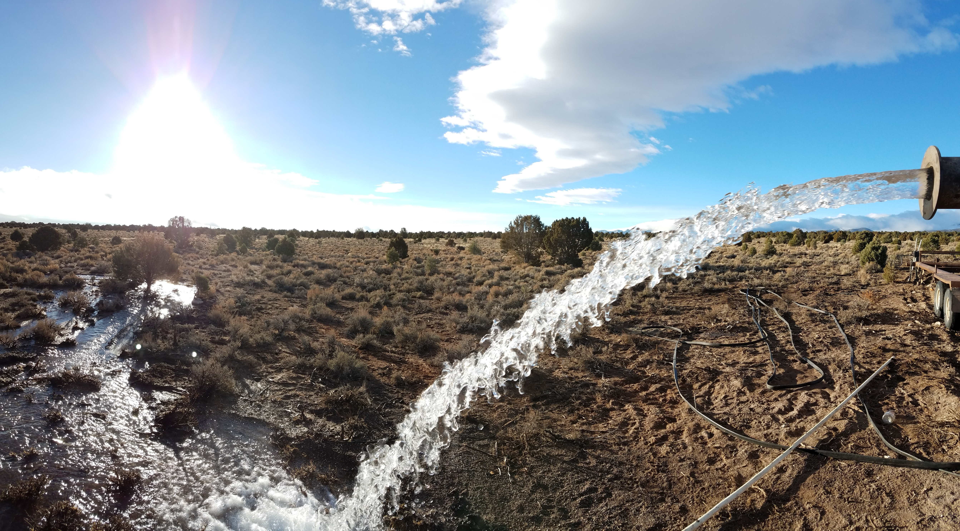

Slide 7
CICWCD.org » Live Water Flows

