Slide 1
American Fork South (55-5),
Provo City South (55-6),
Provo City North (55-7) &
Provo Canyon (55-9)
Subdivisions
List of Unclaimed Rights
Public Meeting
September 2, 2020
Utah Division of Water Rights
Michael Drake, P.E.
Assistant State Engineer - Adjudication
www.waterrights.utah.gov

Slide 2
Electronic Meeting Statement
The holding of a meeting in person at an anchor location presents a substantial risk to the health and safety of those who may be present due to the ongoing COVID-19 pandemic. Public meetings held by the State Engineer regarding the adjudication of water rights in the past have drawn in excess of fifty (50) people. Current guidelines from the Governor’s Office recommend limiting gatherings and groups to fifty (50) people and encourage working remotely whenever feasible. Therefore, the State Engineer determines that holding this meeting through electronic means without an anchor location will best serve the State of Utah’s efforts to combat COVID-19 while still allowing interested members of the public to participate in proceedings.

Slide 3
Agenda
Adjudication Process Review
List of Unclaimed Rights Overview
Accessing the List of Unclaimed Rights
Anticipated Timeline
Questions
Questions can be emailed to:
waterrights_adjudication@utah.gov

Slide 4
The Adjudication Process
1
2
NOTICE
3
SUMMONS
PETITION
Sep. 1, 1944
July 2019 to Dec. 2019
May 2019 to Sep. 2019
4
5
6
7
90 DAYS TO FILE OBJECTION
PUBLIC MEETING
NOTICE TO FILE
CLAIMS WITHIN 90 DAYS
LIST OF
UNCLAIMED RIGHTS
UNCLAIMED RIGHTS
In Progress
90
90
The Adjudication Process
June 2019 to October 2019
Nov. 2019 to Dec. 2019
July 2020 to August 2020
8
9
10
11
PUBLIC MEETING
OBJECTION
RESOLUTION & DECREE
CLAIM INVESTIGATION
PROPOSED DETERMINATION
In Progress
In Progress
W.U.C.
W.U.C.
P.D.
September 2, 2020
12
13
14
15
90 DAYS TO FILE OBJECTION
PUBLIC MEETING
FINAL SUMMONS
OBJECTION RESOLUTION & DECREE
90

Slide 5
List of Unclaimed Rights
Contents
Title Page
Notice to Water Users
Preamble
Location Map
Unclaimed Rights
Alphabetic Index

Slide 6
List of Unclaimed Rights
Title Page
District Court Jurisdiction
General Adjudication Description
Judge & Civil Number
Hydrologic Division & Subdivision Names
Area & Book Numbers

Slide 7
List of Unclaimed Rights
Notice to Water Users
Instructions on filing an objection

Slide 8
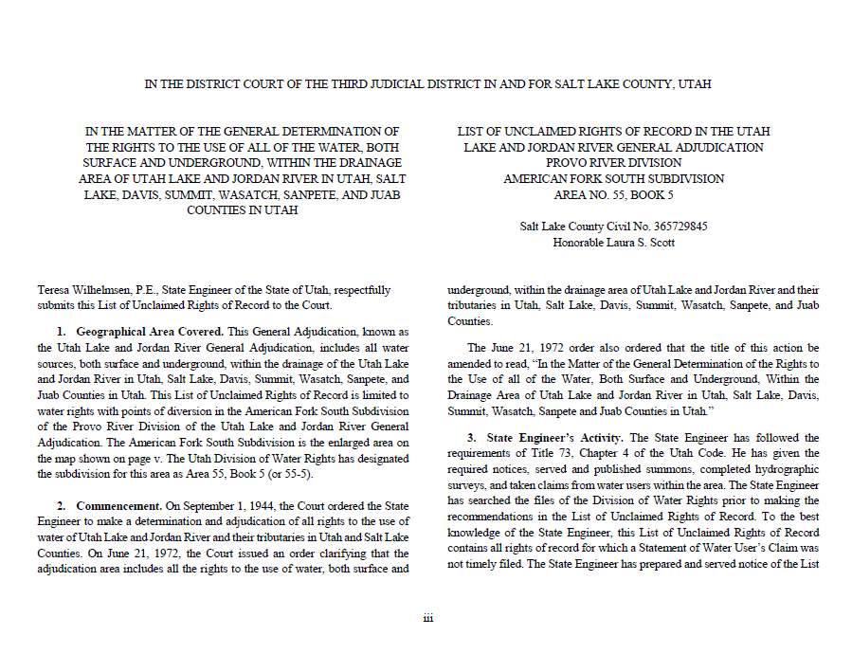
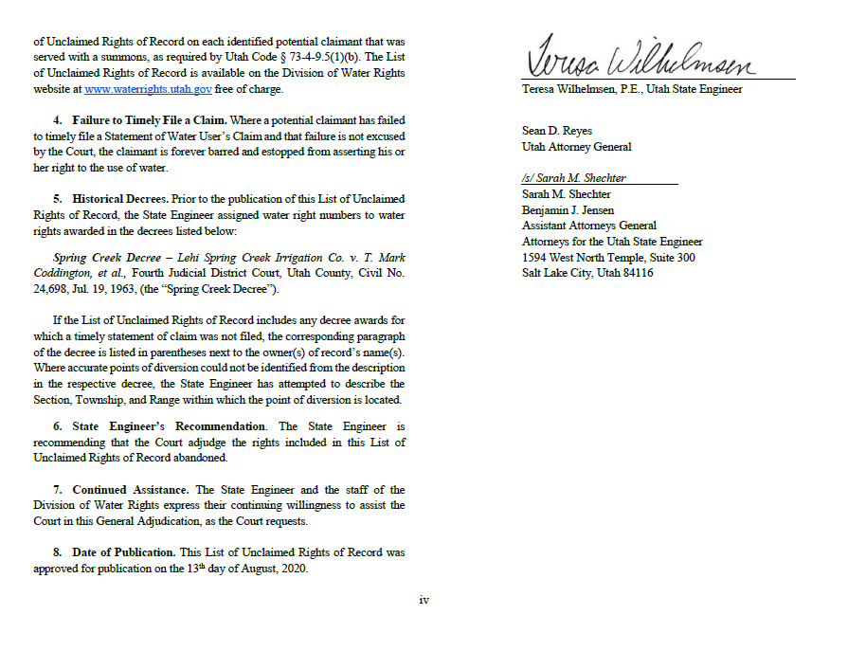
List of Unclaimed Rights
Preamble
Relevant Prior Decrees

Slide 9
American Fork South (55-5)
List of Unclaimed Rights

Slide 10
Provo City South (55-6)
List of Unclaimed Rights

Slide 11
Provo City North (55-7)
List of Unclaimed Rights

Slide 12
Provo Canyon (55-9)
List of Unclaimed Rights

Slide 13
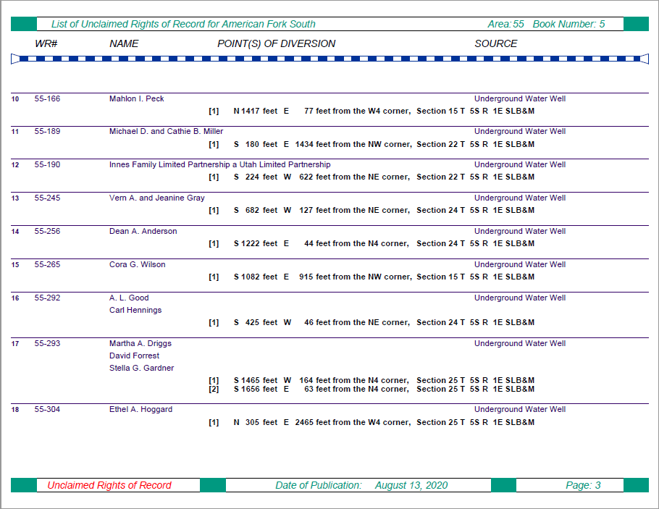
List of Unclaimed Rights
Unclaimed Rights
Water Right Number
Point of Diversion Location and Source
Name of Owner of Record

Slide 14
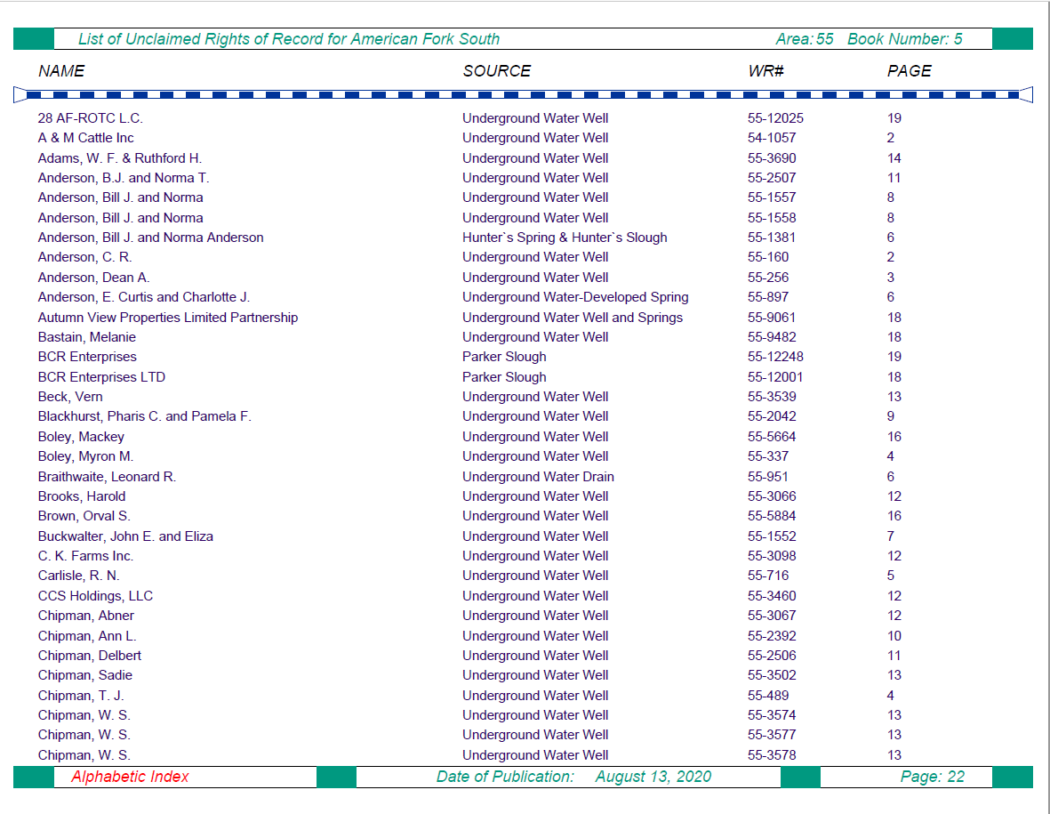
List of Unclaimed Rights
Alphabetic Index
Page
Number
Water Right Number
Name of Owner of Record
Point of Diversion Source

Slide 15
Accessing the List of Unclaimed Rights
Recipients of the Notice of the List of Unclaimed Rights:
Water right owners listed on the records of the State Engineer.
Property owners within the American Fork, Provo City South, Provo City North and Provo Canyon adjudication areas.
Registered agents for corporate entities within the adjudication boundary.
Counsel of record who have filed an appearance in the court.
The List of Unclaimed Rights can be accessed via:
American Fork: http://www.waterrights.utah.gov/pdbooks/AFSLUR
Provo City South: http://www.waterrights.utah.gov/pdbooks/PCSLUR
Provo City North: http://www.waterrights.utah.gov/pdbooks/PCNLUR
Provo Canyon: http://www.waterrights.utah.gov/pdbooks/ProvoCanyonLUR
Hardcopies can be printed at our office for a nominal fee.
Filed at the District Court.

Slide 16
Anticipated Timeline
List of Unclaimed Rights Publishing
Provo Canyon (55-9) July 29, 2020
Provo City North (55-7) August 6, 2020
American Fork South (55-5) August 13, 2020
Provo City South (55-6) August 20, 2020
90-day Objection Period
Provo Canyon (55-9) October 27, 2020
Provo City North (55-7) November 4, 2020
American Fork South (55-5) November 11, 2020
Provo City South (55-6) November 18, 2020
WHAT’S NEXT…?
Proposed Determination
Publish Late 2021 (Approximate)
90-day objection period begins
State Engineer holds a public meeting

Slide 17
Who can I contact to discuss the
Adjudication Process?
Michael Drake, P.E.
Assistant State Engineer
Phone: 801-538-7397
Email:
michaeldrake@utah.gov
John Briem
Adjudication Team Leader
Phone: 801-419-4682
Email: johnbriem@utah.gov
Provo City North (55-7)
Provo City South (55-6)
Nick Yeiter
Adjudication Team Leader
Phone: 385-441-0364
Email:
nyeiter@utah.gov
Provo Canyon (55-9)
Kjori Shelley
Adjudication Team Leader
Phone: 385-321-9323
Email: kjorishelley@utah.gov
American Fork S. (55-5)
General Adjudication Line
801-538-5282
Utah Division of Water Rights
1594 West North Temple
Suite 220, PO Box 146300
Salt Lake City, UT 84114-6300
www.waterrights.utah.gov

Slide 18
Questions?
For online viewers, questions can be emailed to:
waterrights_adjudication@utah.gov

