Slide 1
Cedar Valley/Northern Utah Valley
Groundwater Management Plan
January 15, 2014

Slide 2
Agenda
Previous Meetings
Public Comments
Changes to Draft Plan
Webpage and Water Rights Listing
Next Steps

Slide 3
Cedar Valley/Northern Utah Valley
Groundwater Management Plan

Slide 4
Previous Meetings
1995 – Utah Valley and Cedar Valley
Groundwater Management Plans
2004 – Cedar Valley
Cedar Valley Groundwater Policy
Filings transferring into Cedar Valley will be held

Slide 5
Previous Meetings
2010 – Northern Utah Valley
Presented Data from USGS Study & water rights
Interim Policy
Applications which represent a new groundwater withdrawal from the Northern Utah County Groundwater Management Area filed after September 30, 2010, will be held
2013 – Cedar Valley
Presented Data from UGS Study & water rights

Slide 6
Previous Meetings
2013 – Cedar Valley and Northern Utah Valley
July 9, 2013
Presented draft groundwater management plan
30-day public comment period

Slide 7
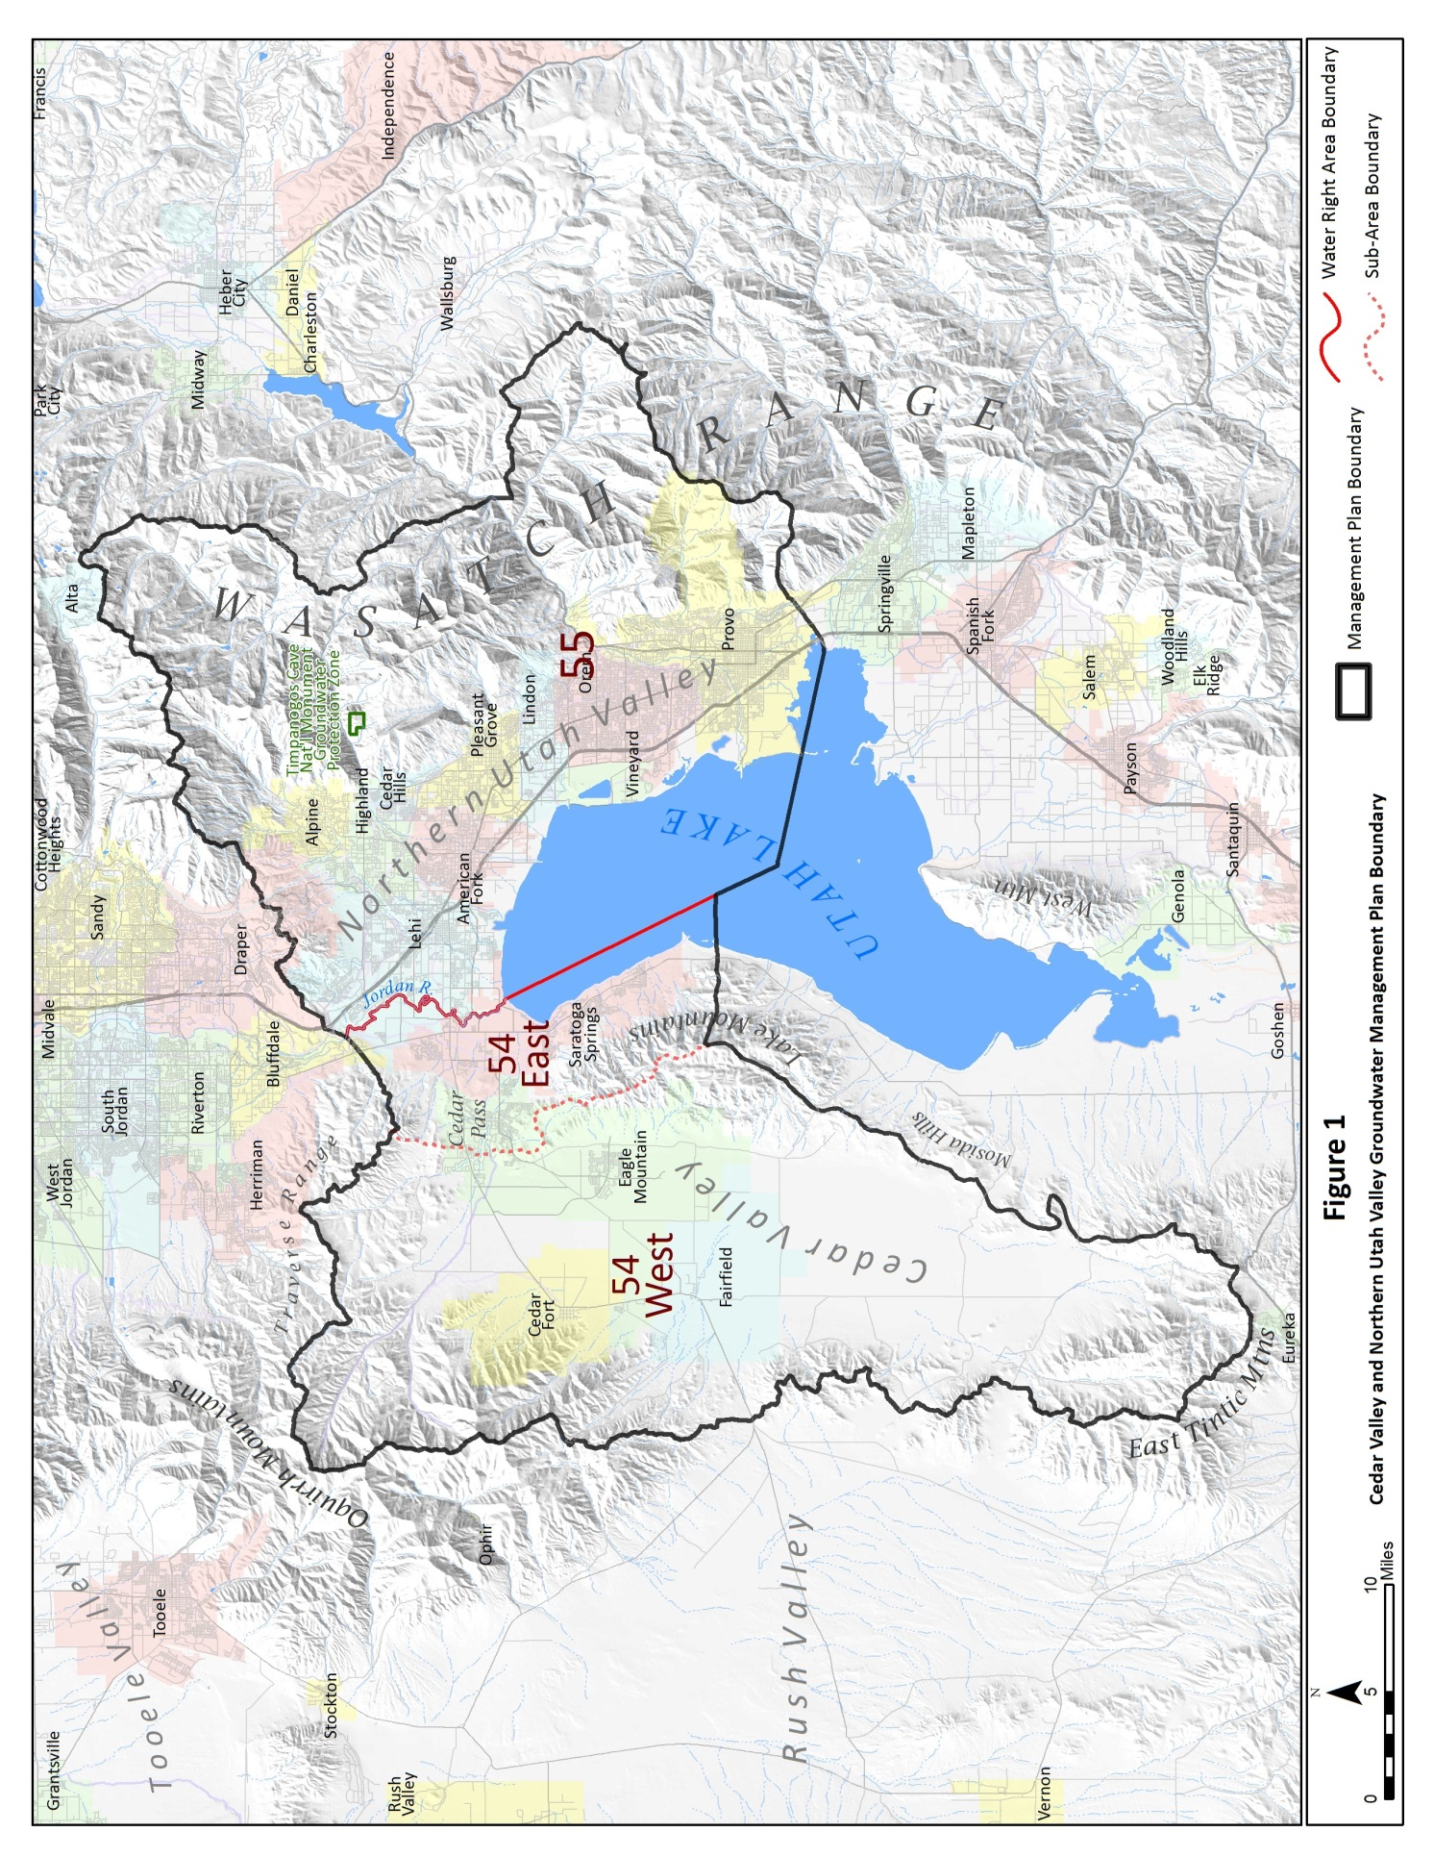

Slide 8
Public Comments
Written comments received from
Fairfield Irrigation Company
Central Utah Water Conservancy District
Lehi City
Highland City
Cedar Fort Irrigation Company
Eagle Mountain City

Slide 9
Public Comments
Concern was expressed that the three existing cities in Cedar Valley - Cedar Fort, Fairfield and Eagle Mountain – should have shared equally any amount of water allowed to “be moved in” the Cedar Valley under previous policies.
No one entity should have a monopoly on the water.
Any additional water should be divided three ways.

Slide 10
Public Comments
Groundwater in Northern Utah Valley does contribute directly to Utah Lake.
Prior water rights should not be impaired by subsequent applications.
Support of proposed restrictions on moving additional surface water to ground water.
Support of this policy to protect existing water rights, require reporting of withdrawals, and allow for future Aquifer Storage and Recovery projects.

Slide 11
Public Comments
Water users should not have the ability to move water rights from one area to another
Water on the west of the Jordan River is of lesser quantity and quality than water on the east
No water right transfers should be allowed between Areas 54 and 55
A list of water rights within the policy areas should be provided

Slide 12
Public Comments
Please address how the groundwater management plan will address how groundwater withdrawals will be managed once safe yield is exceeded
Will annual withdrawal limitations be set?
How will the State Engineer regulate groundwater withdrawals if a voluntary arrangement with all water users does not exist?
How will the State Engineer regulate rights if conjunctive management between surface and groundwater is needed?

Slide 13
Public Comments
Concern is expressed in “rescinding” the 2004 policy modification to the 1995 Cedar Valley policy
No further transfer of paper rights from outside of Area 54 West should be allowed
Plan should be in compliance with statutory criteria and not allow for the impairment of existing water rights

Slide 14
Public Comments
Please provide a listing of water rights included in the evaluation of this plan
Support for rights within Area 54 West and East to be managed as one hydrologic system.
Transfers from Area 54 East to Area 54 West should be restricted to municipal use by a public water suppliers with the place of use in Area 54 West

Slide 15
Cedar Valley/Northern Utah Valley
Groundwater Management Plan

Slide 16
Changes to Draft Plan
Priority regulation
While still allowing flexibility to water users, a buffer distance from the administrative boundary between Areas 54 and 55 defining the Central Zone is changed from 2 miles to 1 mile
Clarification that this policy amends the prior groundwater policies

Slide 17
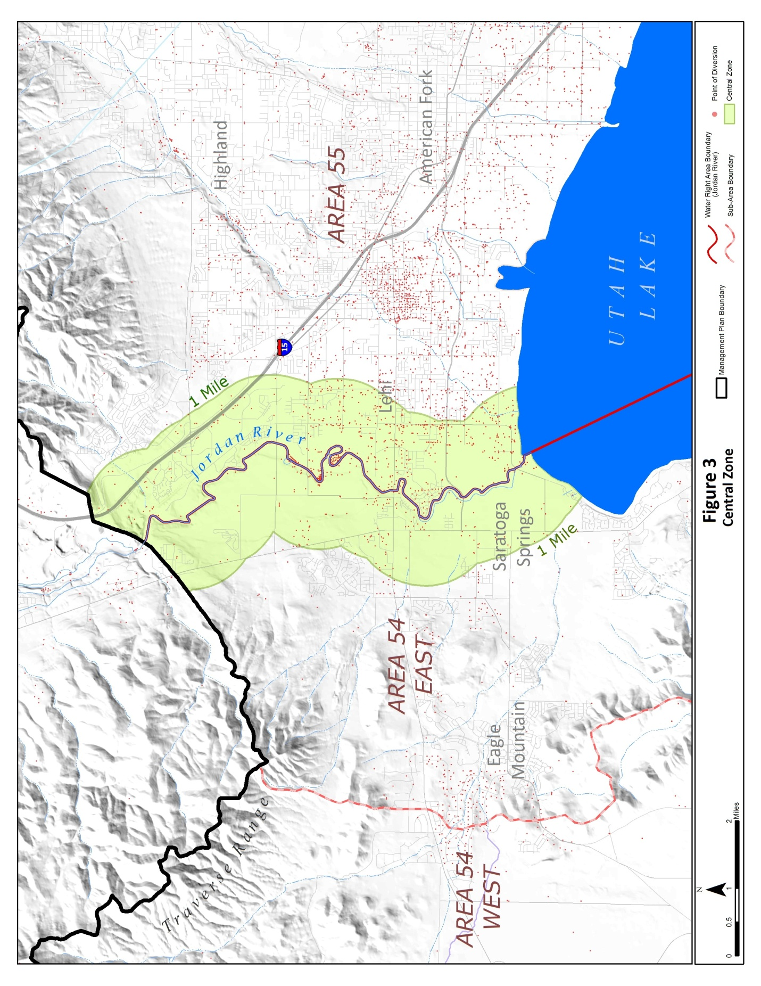

Slide 18
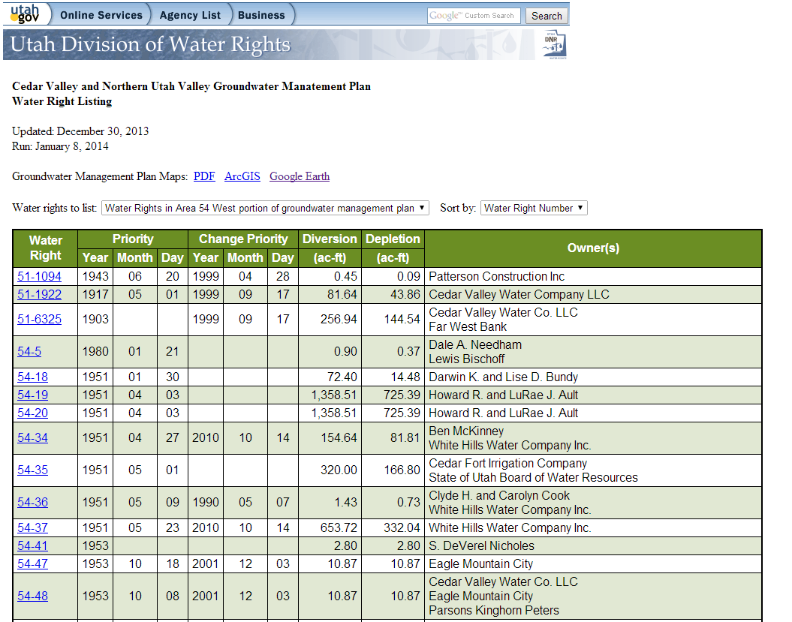
Water Rights Listing

Slide 19
Cedar Valley/Northern Utah Valley
Groundwater Management Plan

Slide 20
Next Steps
Revised policy available today
Notice of adoption will be given within the next week
Final adoption will occur 60 days after the notice is mailed
Water use reporting requirement

Slide 21
Questions/Comments
Address for comments:
Utah Division of Water Rights
Teresa Wilhelmsen, P.E.
1594 W. North Temple, Suite 220
PO Box 146300
Salt Lake City Utah 84114

