Slide 1
Utah Water Users 2014
Legislative Actions
2014 General Session
Mike Styler
March 18, 2014

Slide 4
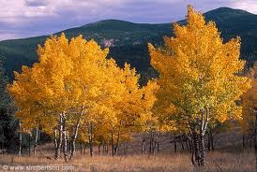

Slide 6
Executive Water Task Force recommended:
HB 29 (Webb) County Recorder Index Amendments
SB 17 (Dayton) Water and Irrigation Amendments
The Concepts that became HB 370 (Anderson) Canal Safety Amendments
Retaining the language of 73-3-3.5
Postponing the SB 109 discussion

Slide 7
HB 29 County Recorder Index
(l) keep an index of water right numbers that are included on an instrument recorded on or after May 13, 2014, showing the date and time of recording, the book and the page or the entry number, and the kind of instrument.

Slide 8
SB 17 Water and Irrigation Amendments
(5) Before the state engineer issues a certificate of appropriation, a right claimed under an application for the appropriation of water may be transferred or assigned by a written instrument. (6) An instrument transferring or assigning a right described in Subsection (5) shall be recorded in the office of the applicable county recorder to provide notice of the instrument's contents

Slide 9
SB 17 Continued…
A person engaged in well drilling, as described in Subsection 73-3-25(1)(c), is guilty of a crime punishable under Section 73-2-27 if the person does not have a current license to engage in well drilling, as provided by this title

Slide 10
SB 17 Continued…
(7) The state engineer may issue an order for the repair and restoration of the bed and banks of a natural stream channel altered contrary to, or without, a permit issued for that purpose.

Slide 11
SB 17 Continued…
(a) divide water among several appropriators entitled to the water in accordance with the right of each appropriator;
…and allows State Engineer Access for regulation of reservoirs and canals…

Slide 12
HB 49
Modifies Change applications so Stock Holders in Irrigation companies file directly with State Engineer.
Requires Irrigation Companies to pay costs associated with Change Application
Requires mediation before litigation
Never heard by Senate

Slide 13
SB 211
Provides legislation solutions to Big Ditch Case and Jones v Jensen Case
Was never heard by the House
Water Right at Issue in Jones v Jensen was recently ruled to be forfeit by District Court

Slide 14
North Jordan Canal

Slide 15
HB 370 Canal Safety
Requires State Engineer to inventory all open canals > 5 second ft. recording:
1. alignment
2. Owner information
3. Maximum flow capacity
4. If used as Storm Water conveyance
5. Whether a management plan exists
Canal Owner required to update above Info

Slide 16
Canal Safety continued…
State Engineer may contract with Conservation District (or anyone qualified) to assist in the inventory work
State Engineer may contract with Conservation District (or anyone qualified) to provide technical support for canal owners in adopting a management plan

Slide 17
SB 274 (Dayton) Water Jurisdiction Amendments
Removes requirement livestock watering right be jointly acquired by public agency and grazer
It forbids grazing renewal predicated on transfer of water right to public agency
It allows safety net for a potential partial forfeiture of water right due to grazing reduction. State Engineer holds the right

Slide 18
Executive Water Task Force
Executive Water Task force will continue to meet and provide a forum for water users.
A long list of Master Study items will be discussed.
Further refinements to Canal Safety will occur
Compromise will be sought on this year’s Failed Bills

Slide 19
Western Water Law — Origin and History
Appropriative water rights are given a priority based on their date of creation
In times of shortage, earlier priority rights are filled first to the limit of the right
No sharing of shortages means some uses will be met
The intent was to maximize public benefit

Slide 20
Western Water Law — Origin and History
An appropriative water right in Utah is a conditional right to use a shared resource
Conditional because water is a public resource and to get a private right to use it legislative requirements must be met
The most important = continued beneficial use of the water (or non-use application)

Slide 21
Western Water Law — Origin and History
The right to use is not ownership of a volume of water, but a right to use an amount of water for a beneficial purpose
Since water rights are shared, everything one right-holder does impacts others and any change in use must not harm others
Each system has a finite amount of water

Slide 22
What is the Most Serious Threat to your water rights?
Legislative and Judicial limits Placed on State Engineer!

Slide 23
Notes:
Cover Slide Option 2
Headline, Subhead and Subsubhead centered
Please note… This background can also be used for interior slides as well!

Slide 24
Depletion vs. Permitted use
The Key to understanding the “BLACK BOX”
is understanding the difference:

Slide 25
They are different:
A “depletion” is the amount of water consumed and not available for return to the groundwater system
A permitted use is the sum of the depletion plus return flow to the groundwater system
so for instance…

Slide 26
Farmer John has 300 acre feet of water and uses all 300 to irrigate 100 acres. His flood irrigated system consumes 170 acre feet. 130 acre feet percolate into subsurface.
The Depletion is 170 Acre Feet
The permitted use is 300 Acre Feet
The limit of his right is irrigating 100 acres.
So What if Farmer John decides…

Slide 27
To Sell his Land and Water to Proctor and Gamble?
How much water can he sell if P&G will deplete 100% of the water?
Farmer John depleted 170 acre feet on his farm… so that is the depletion allowed through a change application.
Farmer John could sell all 300 acre feet if he sold the ground and water to another farmer since the permitted use would stay the same and the assumed depletion would be constant

Slide 28
Western Water Law — Origin and History
Appropriative water rights are constitutionally protected property rights
Their basis is the beneficial use of water
They are defined by quantity, time, and nature of use and can be lost by non-use
Priority date is when beneficial use began
They can be lost by non-use
Notes:
The need for beneficial use is so important because it pays back the public for allowing a person to privatize the water by holding a water right and because it “keeps the system real” in terms of requiring actual beneficial use instead of simply doing paperwork.

Slide 29
So, How can we protect water rights?
of HB 51 weakened foundation
Tsunami of “Jones V Jensen” Supreme Court Decision finished the destruction
1.1. We must Maintain State Engineer as the gatekeeper
2. All water legislation needs Water Task Force exposure
3. Legislators must be helped to understand water law
4. Outreach and education is needed for those who lobby water issues
Notes:
Cover Slide Option 2
Headline, Subhead and Subsubhead centered
Please note… This background can also be used for interior slides as well!

Slide 30
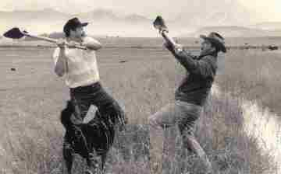
Whiskey for drinking, water for fighting!
Notes:
Regional Offices:
Cedar City, Logan, Vernal, Richfield, Price

Slide 31
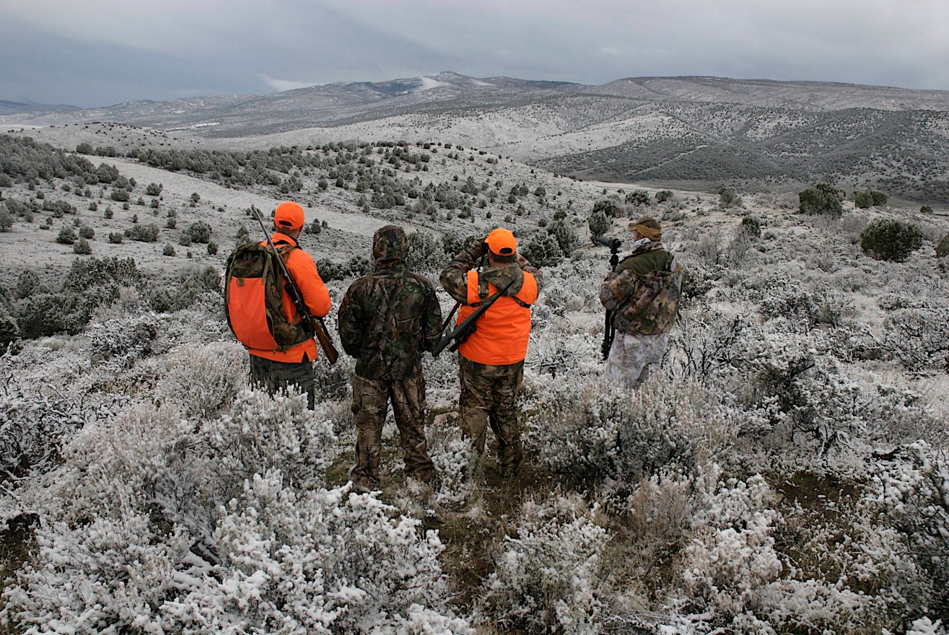
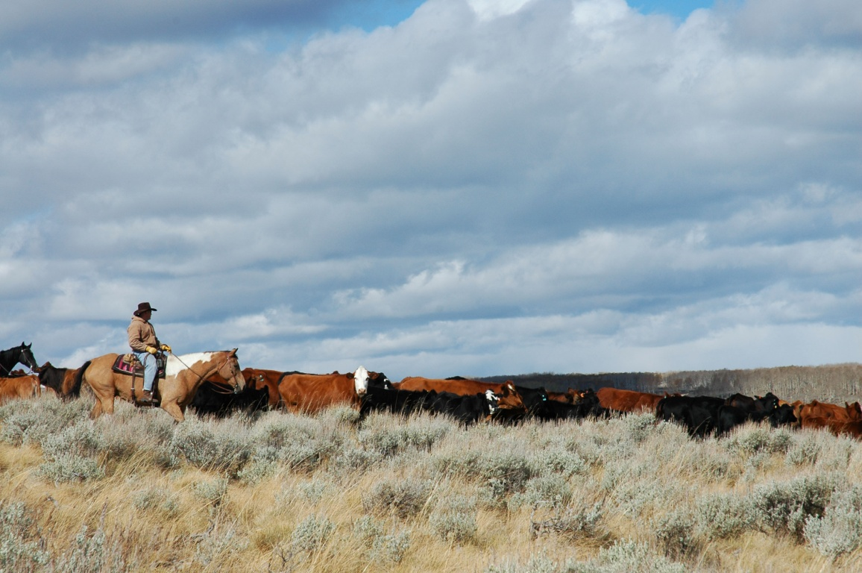
Creating Healthier Lands Supports Diverse Uses

Slide 32
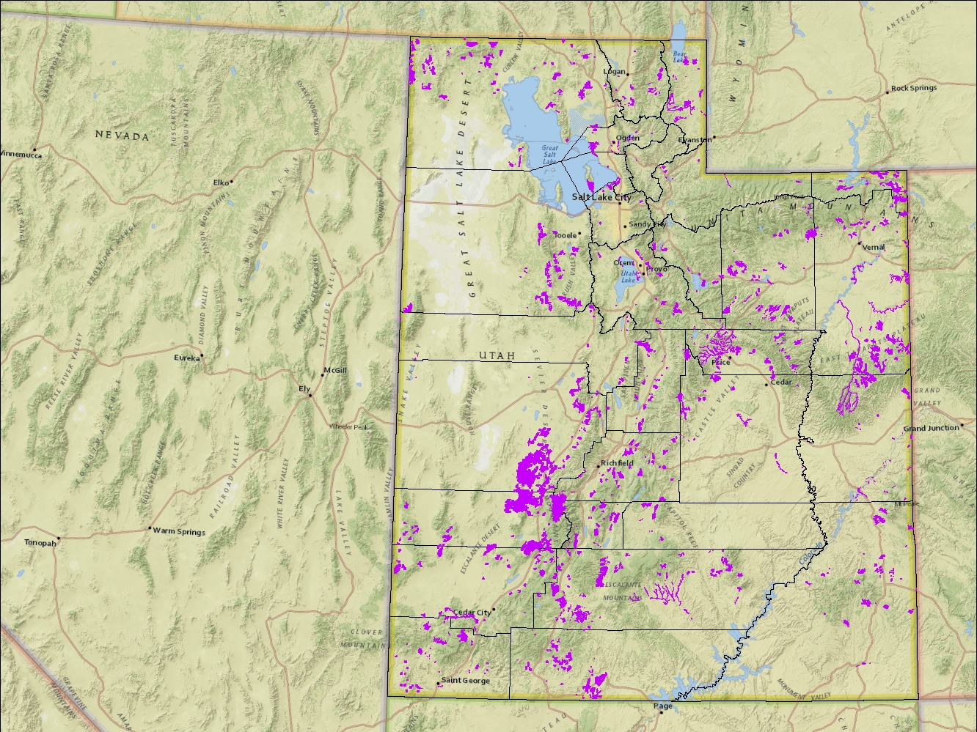
Utah’s Watershed Restoration Initiative
Completed and Current Projects:
1,164 projects since FY 2006
1,020,491 acres
$16,753,723 DNR funds
$98,490,688 partner contributions
For every DNR $1 spent, we have leveraged nearly $6 from partner contributions.
Notes:
With state boundary and counties (in background)

Slide 33
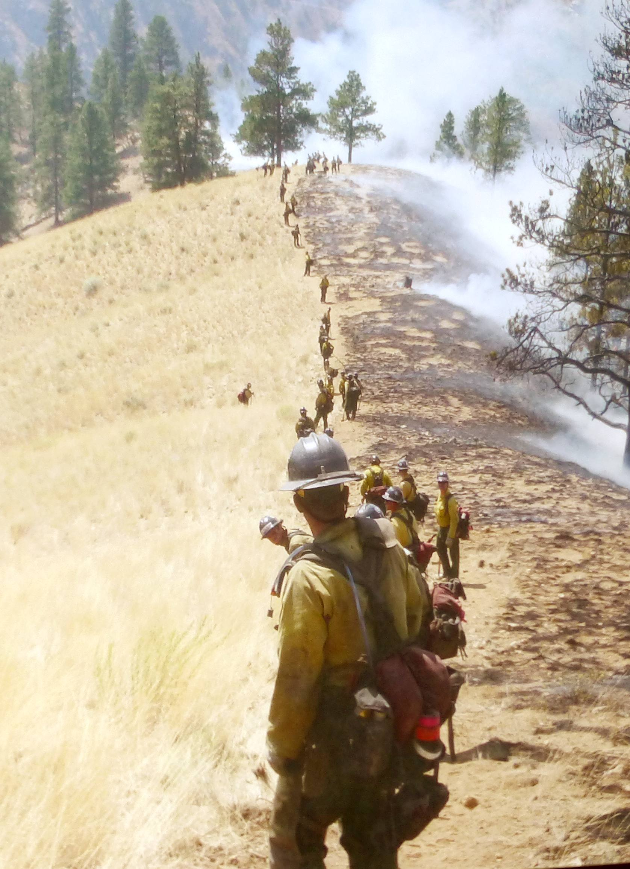
2013
Fire Suppression
And
Restoration Costs
(And the rest of the story)
Department of Natural Resources

Slide 34
The Bad News (Overall)….
- Burned almost a half million acres statewide so far…
- Mud flows
- Loss of Life
- Increased sedimentation into reservoirs
- Structures burned
- Loss of wildlife habitat
- Loss of grazing opportunities
- Devastating fish kills in “blue ribbon” fisheries
- Future fire suppression in recent burn areas costs more money.

Slide 35
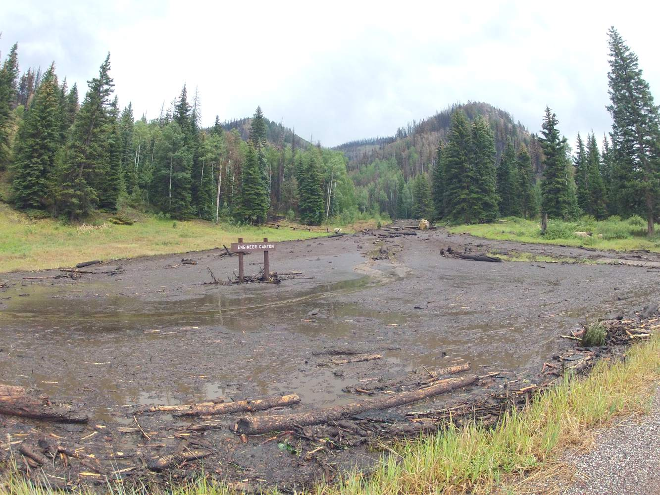
Seeley

Slide 36
The Good News Is
This Provides an Opportunity To:
- Manage the recovery of the watershed.
Improve water quality and quantity.
Increase forage for both livestock and wildlife.
Reduce the threat of future catastrophic wildfire.
Replace invasive plants with desirable species.

Slide 38
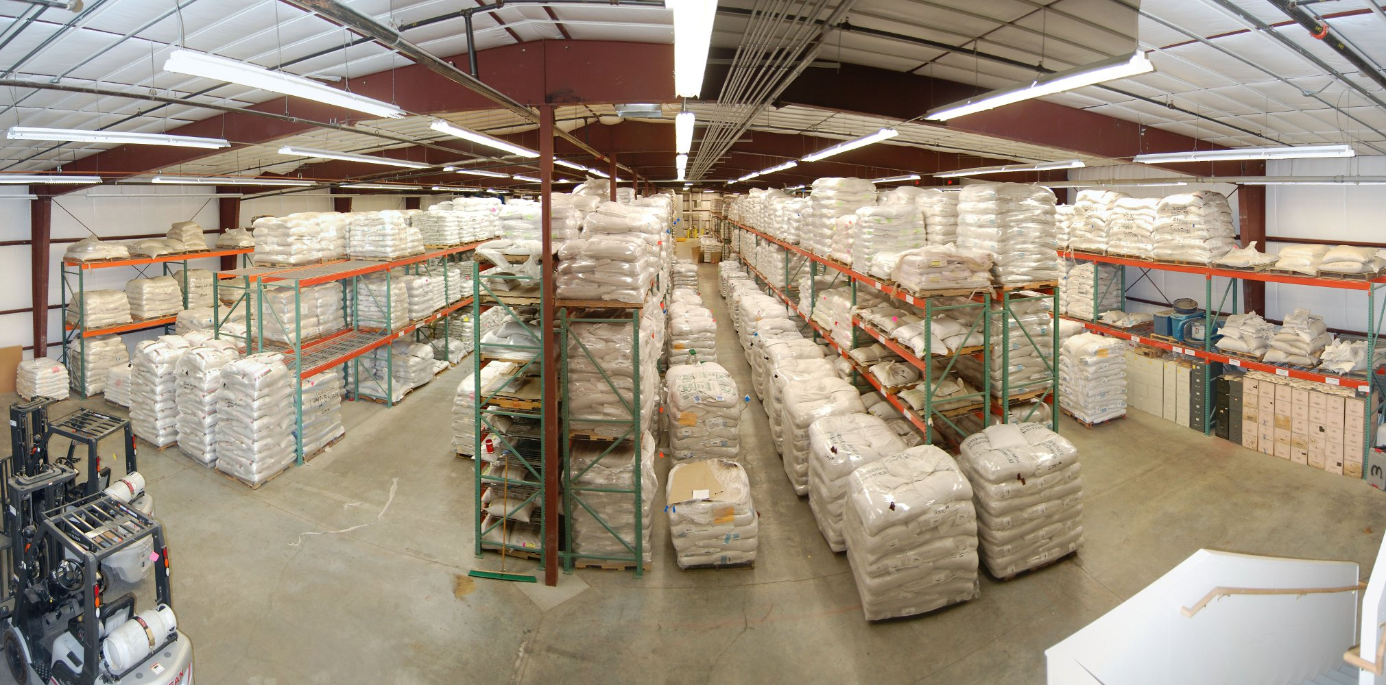
This is how we do it….
Seed purchasing
Seed storage/mixing facility in Ephraim, UT

Slide 39
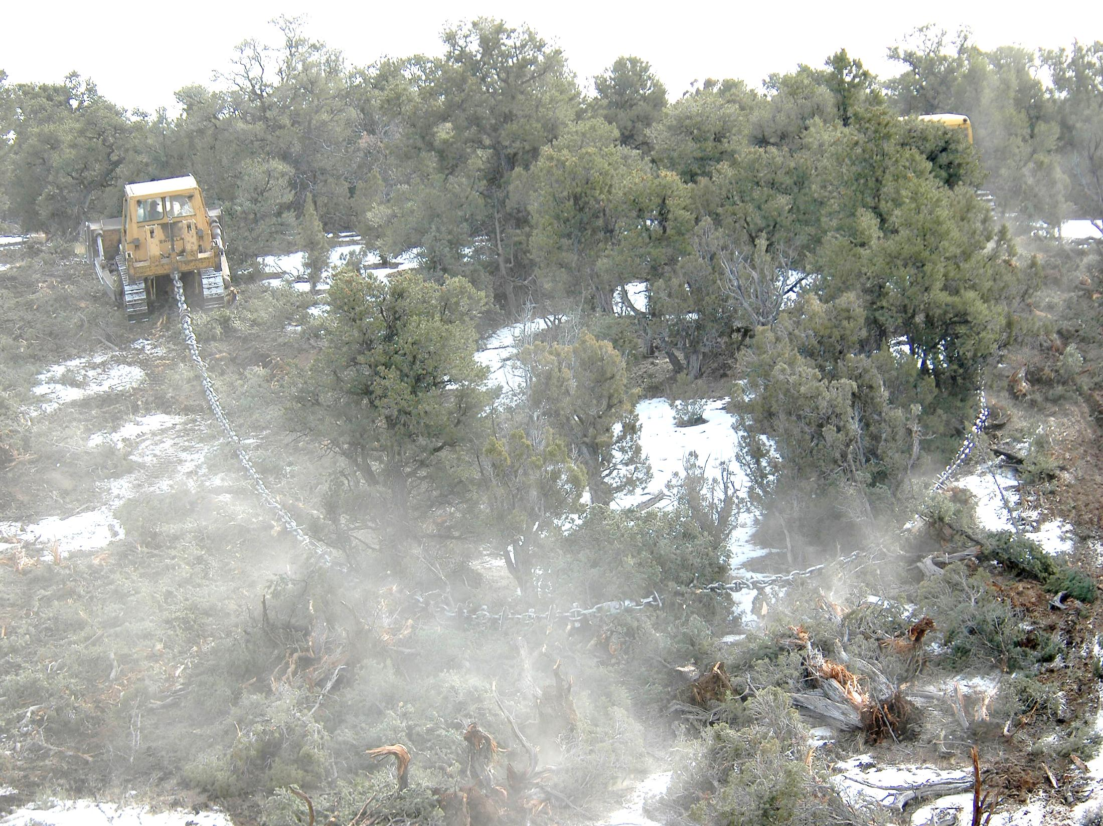
Watershed Rehab/Treatment Methods

Slide 40
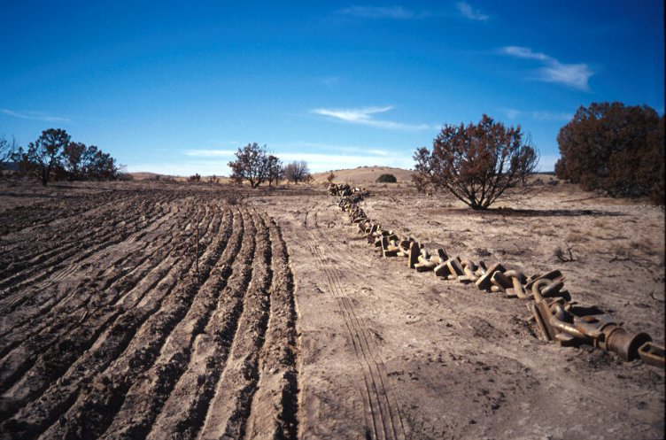
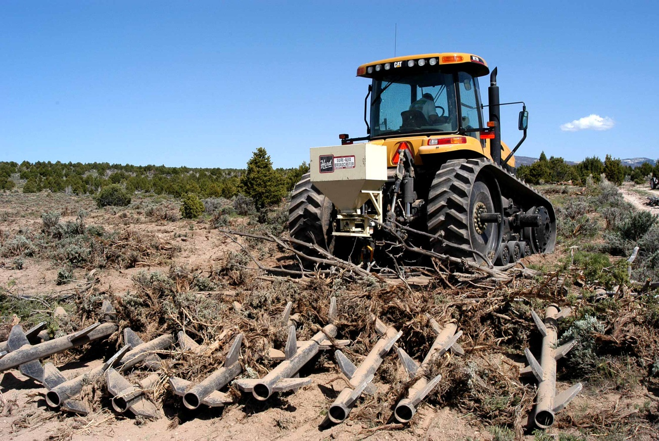
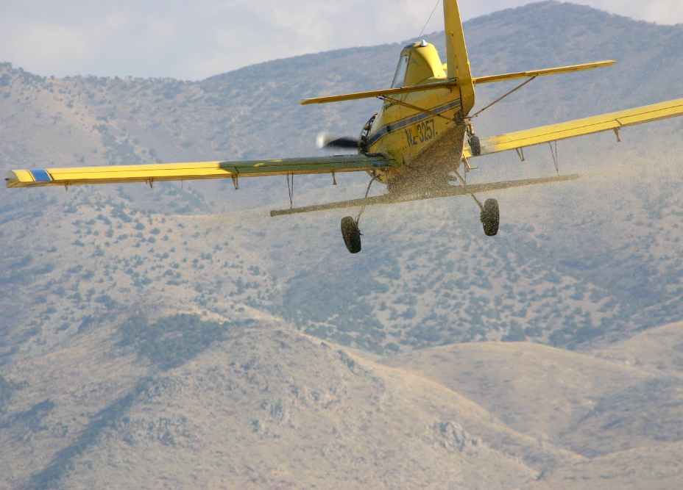
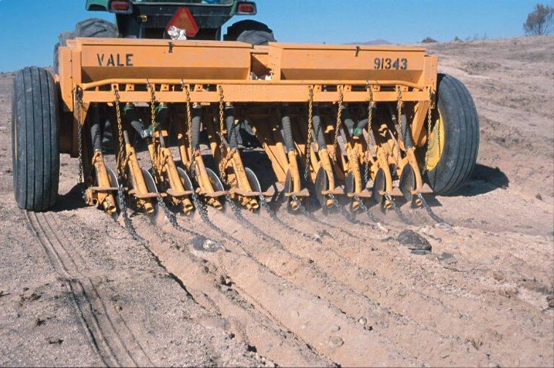
Watershed Rehab/Treatment Methods
Watershed Work in Progress
Chaining Photos

Slide 41
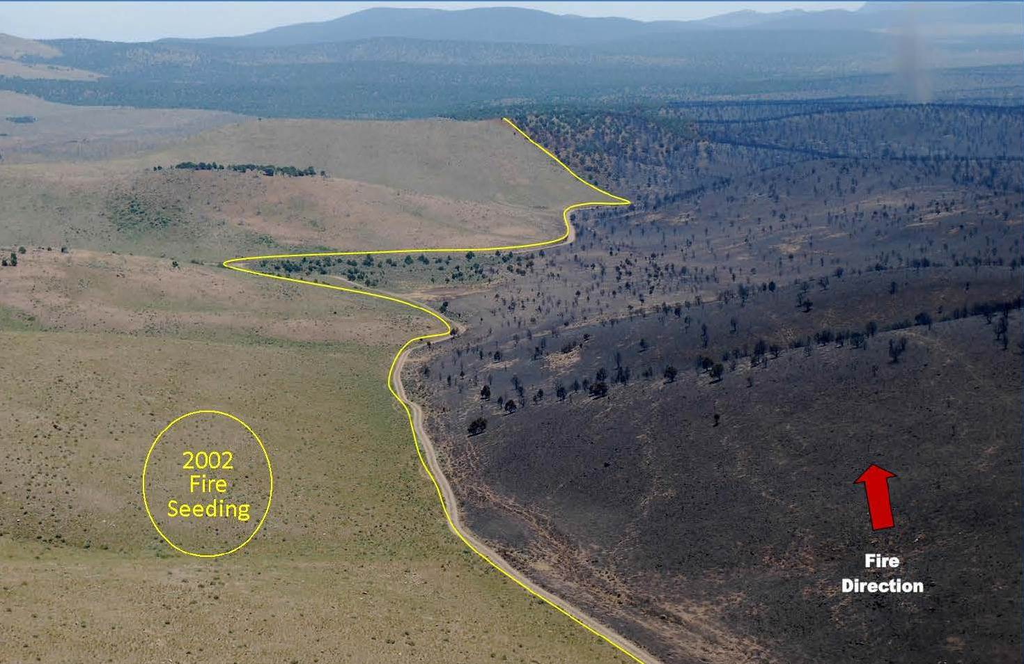
2013 Black Mountain Fire
Watershed Restoration Initiative
Post Fire Seeding
Saves Dollars, Habitat
Helps Firefighters Fight Future Fires Reducing Their Size
3 miles southeast of Minersville
2002 Maple springs fire re-seeded with diverse flame resistant seed mix
Millions of fire suppression dollars saved
Thousands of acres saved from burning

Slide 42
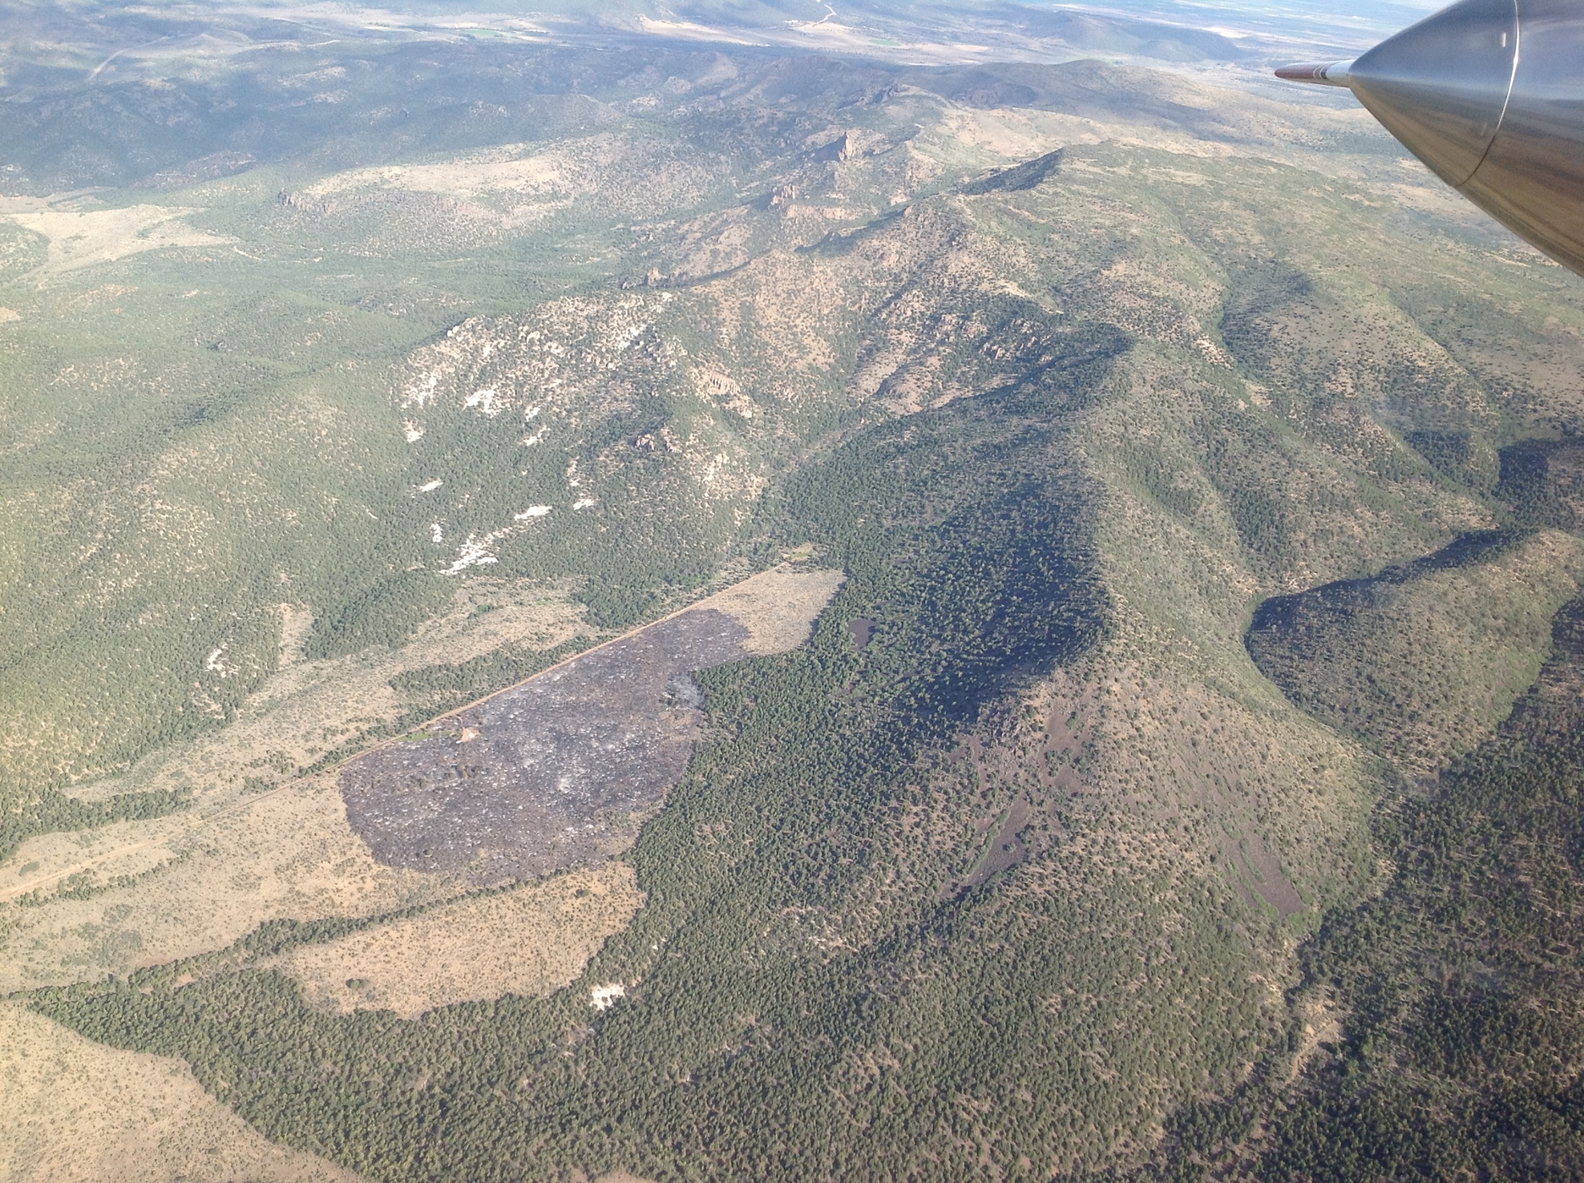
2012 Atchinson Fire
Utah’s
Watershed Restoration Initiative – Pre-Suppression Projects Help Slow or Stop Large, Destructive, Out of Control Wildfires
2 miles from towns of Central and Pine Valley
Trees cleared in 1970’s and 2008 by WRI
August 2012 lightning started fire
Minimal spread (51 acres)

Slide 44
Benefits of Watershed Initiative:
Increased forage (Livestock and Wildlife)
Reduced fire costs and damages
Increased productivity of watersheds (increased volume and quality of yield)
Protection of sensitive species
Reduced siltation in streams and reservoirs

