Slide 1
Use of groundwater modeling to support aquifer management and conjunctive administration in Idaho
Presented at 2015 Association of Western State Engineers Spring Workshop
Jennifer Sukow, P.E., P.G.
June 9, 2015

Slide 2
Overview
Location of modeled aquifers
Collaborative model development
Use of groundwater flow models to support IDWR and IWRB programs
Conjunctive administration of groundwater and surface water
Water delivery calls
Water right transfers
Water bank rentals
Aquifer management
Managed recharge
Voluntary reduction of consumptive use
Planning
Update and refine models to incorporate new data

Slide 4
Collaborative model development
Eastern Snake Plain Aquifer
IDWR, U of I, USBOR, USGS, Idaho Power, water users and consultants
Spokane Valley Rathdrum Prairie
USGS, IDWR, WDOE, U of I, WSU
Treasure Valley
U of I, IDWR, United Water, BSU, USGS, USBOR, IWRB, counties and cities
Wood River Valley
IDWR, USGS, cities, TNC, water users and consultants
Transparency and open source software (MODFLOW)

Slide 5
Water delivery calls, evaluate effects of curtailment

Slide 6
Water delivery calls, evaluate effects of mitigation projects

Slide 7
Water right transfer applications, evaluate effects on river reaches

Slide 8
Evaluate aquifer recharge sites

Slide 9
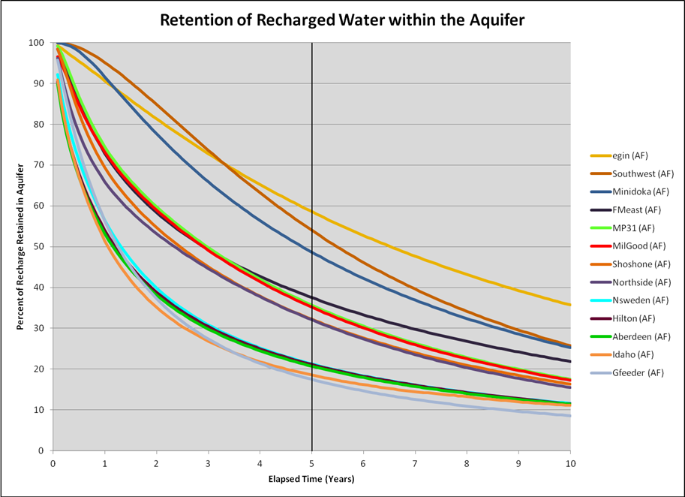

Slide 10
Evaluate effects of projected future water use

Slide 11
Evaluate effects of proposed groundwater development

Slide 12
Continue improving models
Identify data gaps during model development and calibration
Collect additional data
new monitoring sites
new sources of historic data
new methods for evaluating remotely sensed data
Add more years to model calibration period
Advances in modeling software
Periodically release new model versions
Requires continued funding for data collection, data processing, and model recalibration

