Slide 1
Utah Division of Water Rights
RWAU Water Right Training
Overview/Review—April 2016
Boyd Clayton
Assistant State Engineer
June 21, 2004

Slide 2
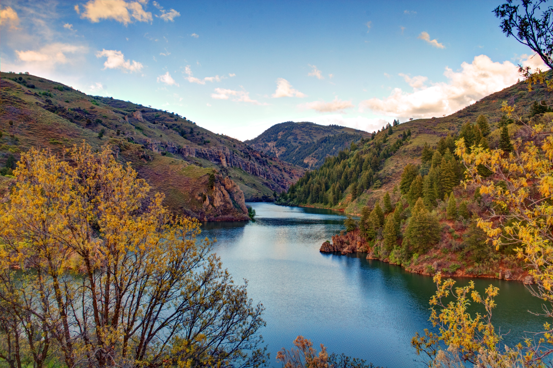
What is a Water Right and Why Do we have them?
Riparian Rights and the West

Slide 3
How and why do water rights vary
Across the United States

Slide 4
73-1-1 Water is a Public Resource 73-1-3 Rights are limited by Beneficial Use 73-1-4 Right is revocable if not used 73-1-5 Beneficial use is a public use 73-1-6,7 Riparian control defeatable 73-1-8 Duty to not waste or injure 73-1-10 Water rights conveyable
Basic Principles

Slide 5
When do you need a water right? How do you get a water right? How don’t you get a water right? What else might you get?

Slide 6
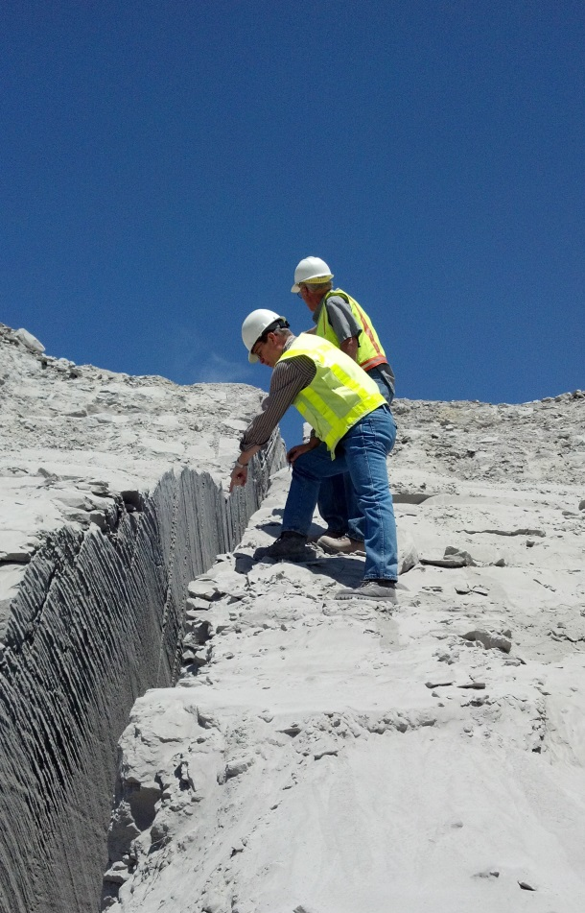
State Water Agencies
Divert and use waters of public
State Engineer
DNR, Division of Water Rights
Water Planning and Project Development
Water Resources Board
DNR, Division of Water Resources
Control of pollutants in public waters
Water Quality Board
DEQ, Division of Water Quality Drinking Water Safety
Drinking Water Board (DEQ, Division of Drinking Water)

Slide 7
Utah State Engineer
Appointed by Governor for 4 year term
Confirmed by Senate
Licensed Professional Engineer
Knowledge of water issues, water laws, state water resources
Division of Water Rights - Support Staff
SE serves as director of Division
Department of Natural Resources Agency
Responsible for Water Right Administration
Serves without a board / No superior agency review
Gatekeeper to provide order and certainty
Reduces potential for conflict
Protects investments
Respect for existing rights
Public waters appropriated according to policy set by legislature
Decisions reviewed de novo in district courts

Slide 8
Informal Administrative Process (Governed by UAPA)
Application Filing (Request for Agency Action)
Notice
Protests
Hearing (optional)
Study
Decision
Reconsideration/ de novo review
Development
Proof/Extension/Lapsing
Issuance of Certificate (Vested Right)

Slide 9
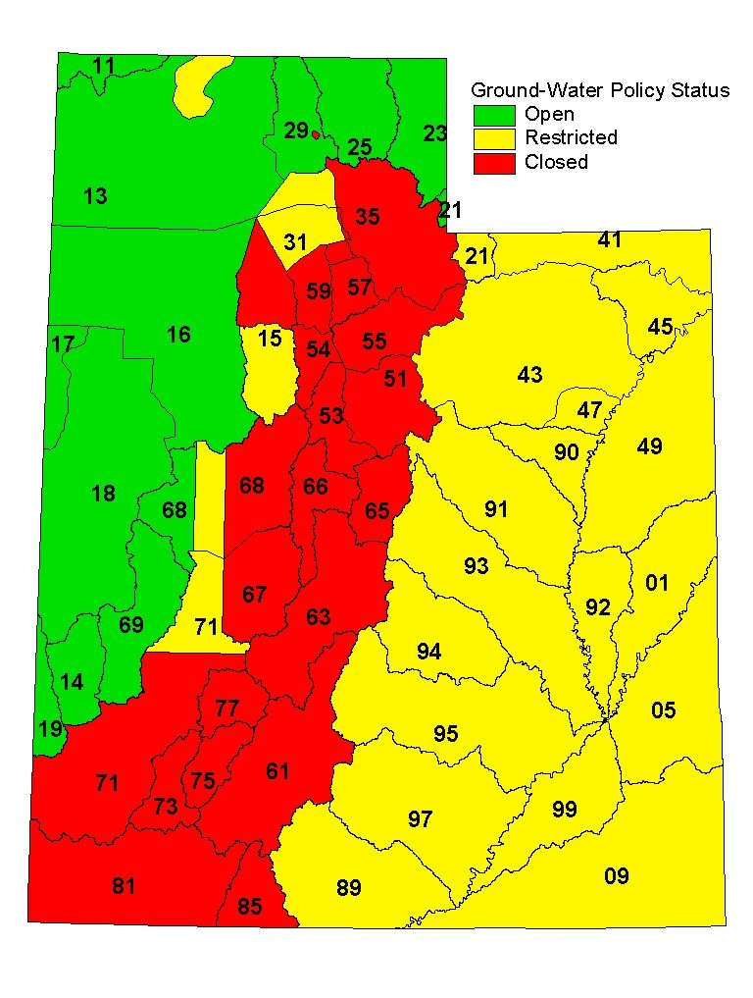
Water
Appropriation Policy
And Resource Studies

Slide 10
Water Use Terms
Duty (maximum reasonable diversion amount)
Depletion (consumptive use)
Irrigation (generally about 0.5 x duty)
Domestic with Septic waste (20 percent)
Municipal (sec. water, waste treatment, reuse)

Slide 11
Water Right Title

Slide 12
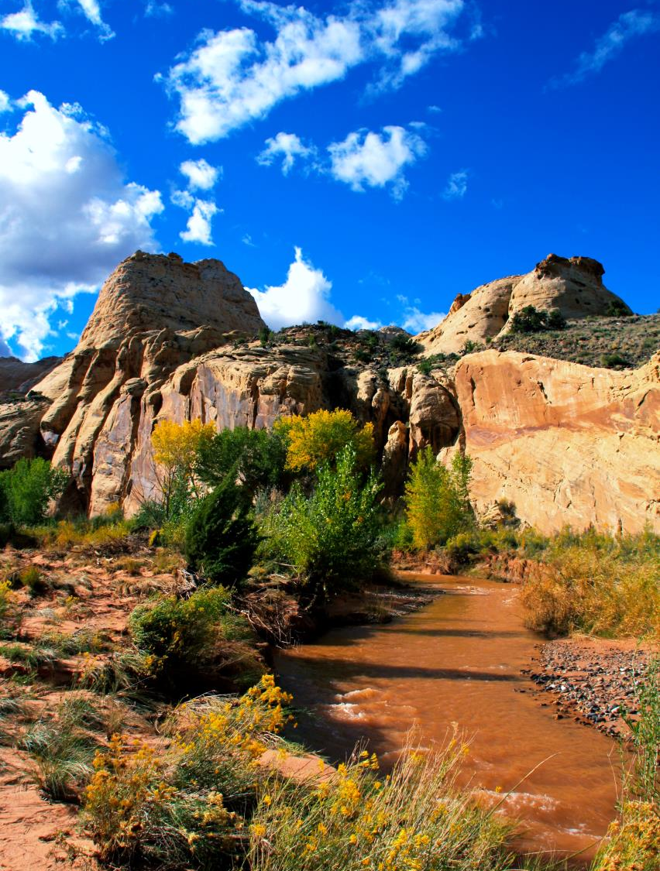
Where Do Water Rights Come From?
Applications
Pre-statutory use (Diligence Claim)
Decrees
Federal Reservations

Slide 13
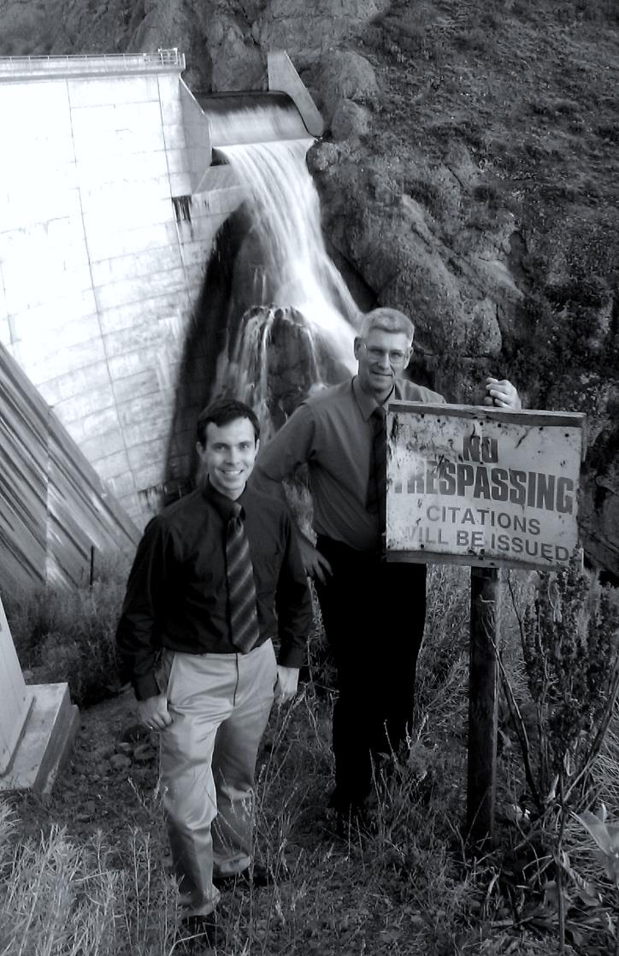
Water Right Record Keeping
Record maintained by State Engineer
Water Right Applications
Assignments
Certificate
Use Records
Current Owner
Record maintained by County Recorder
Certificate
Deeds (conveyance of water right)
Index of water deeds

Slide 14
How Water Right Conveyance Works
Water Rights transfer by deed in substantially the same manner as real estate.
Like real estate there is a race to record. A deed is ineffective if a previous recorded deed conveyed.
Appurtenant water rights transfer silently with land.
Water rights may be reserved from transfer in land deeds.
Water rights may be transferred before land by water deed.

Slide 15
Appurtenant Transfer Water Right Principles
Definition: pertaining to something that attaches. In real property law this describes any right or restriction which goes with that property, such as an easement to gain access across the neighbor's parcel, or a covenant (agreement) against blocking the neighbor's view.
Is the use attached to the land?
If not uniformly appurtenant, where is it appurtenant?
Does the grantee of the land have an interest to convey?

Slide 16
The Appurtenance Quagmire
No complete WR ownership index in counties
Water right silence leaves question in every land deed
Appurtenant water rights not apparent on deeds
Divided land WR interests not transparent
Silence leaves room for dispute between grantors and grantees
Undocumented transfers in PDs
Changes in statute on when appurtenance applies.

Slide 17
Where is Ownership Information?
New Applications
SE Records
Assignments
SE Records
Land Deeds
County Recorder - Silence
Reservation Land Deeds
County Recorder, no index
Water Deeds
County Recorder - Somewhere
Decrees

Slide 18
Bringing Title at SE Office Back Together
Report of Conveyance (ROC)
Partial/full Conveyances
Provide documentation and path from current SE listed owner forward
Normally requires professional
Attorney, Engineer, Surveyor, or Title Insurance Agent
Transfer by appurtenance requires a map
Simple transfers by owner
Deed lists WR number
Water Deed Addendums are forwarded by County at recording and are considered filed ROCs if they begin at current SE listed owner
ROCS are declaratory not decision documents
Competing ROCs are a title controversy SE does not resolve

Slide 19
Title Goal
Up-to-date SE ownership record and contact information for all water rights

Slide 20
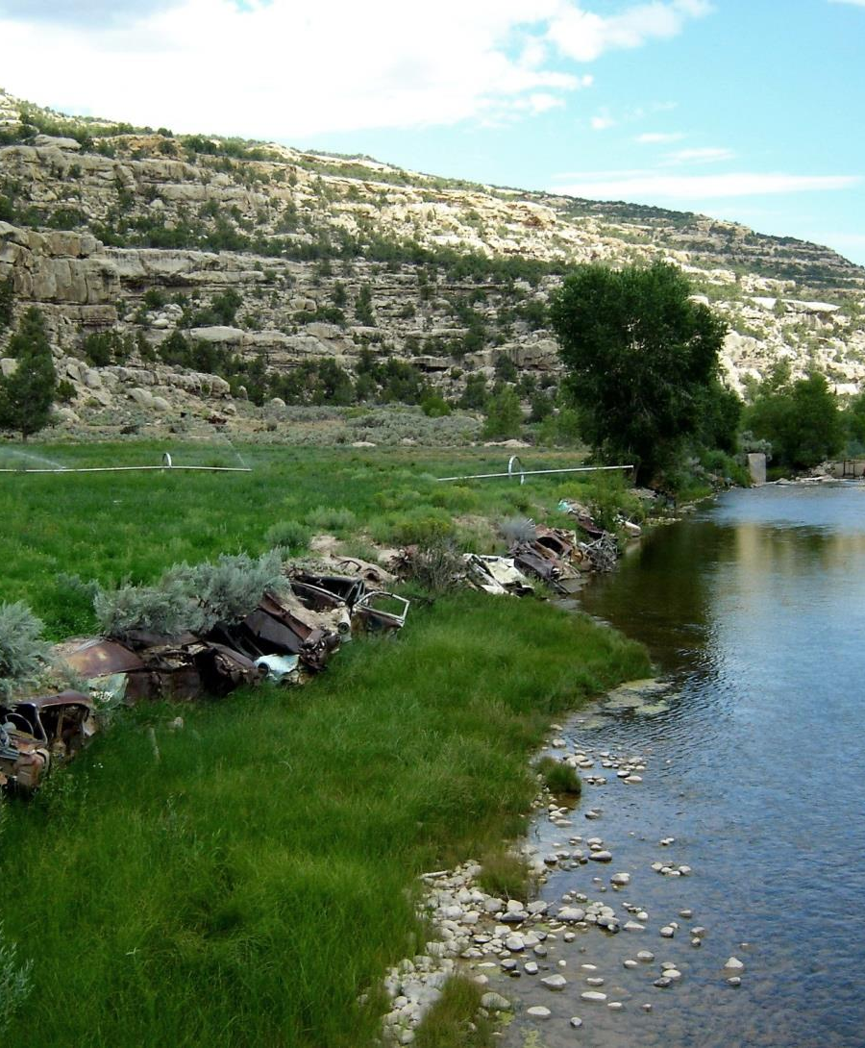
Stream Alterations
Natural Source
To divert you need a water right
To alter you need a state stream alteration permit
Federal permission under clean water act (404 permit)

Slide 21
State Stream Alteration Permits
Fee based on applicant type
Notice to state and federal agencies
Short response timeframe (generally < 30 days)
Approval criteria
Impair vested water rights
Unnecessary adverse effect on public recreation or stream environment
Unnecessarily endanger aquatic wildlife
Unreasonably diminish natural channel flow capacity

Slide 22
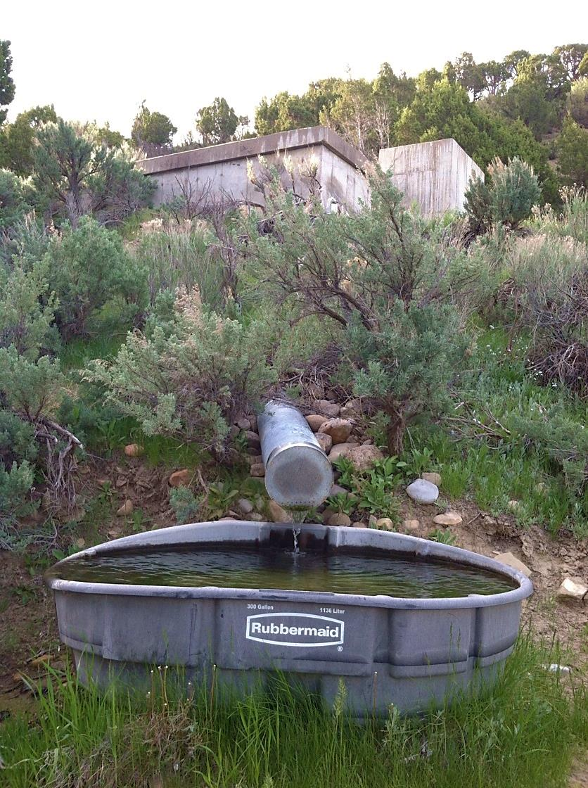
State Alteration Permit Does Not:
Review or grant permission to alter or trespass on land
Grant other local or federal permits except as stated
Relieve applicant from suit for injury by other parties

Slide 23
State and Federal Permit Coordination
State permit can be filed as a joint permit
State stream alteration permit
Coverage under GP10 permit issued to Utah eliminates need for 404 permit
US Army Corps of Engineers (USACE) decides suitability
Cultural resources
Endangered species
Clean water act implications
State approval will state if GP40 coverage is granted
State and Federal Enforcement for failure to secure a permit
State allows after the fact permits with corrections as alternative to enforcement.

Slide 24
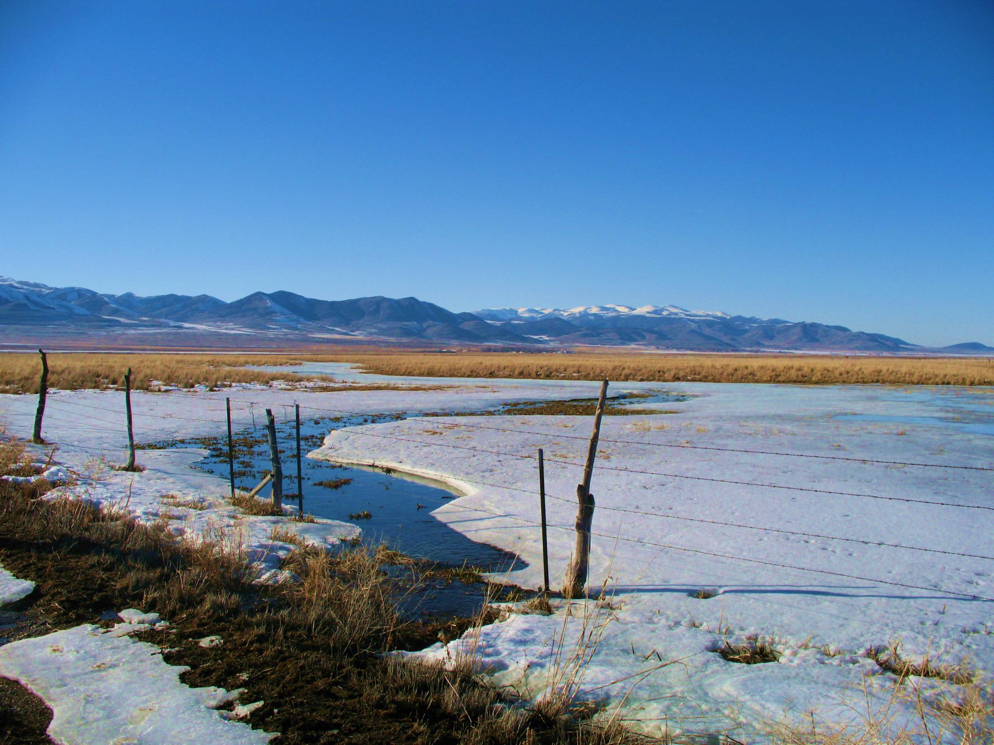
Questions?

