Slide 1
Utah Division of Water Rights
Applications: Approval Criteria & Hearings
RWAU Training – April 2016
Marc K. Stilson, P.E., CPM, M.ASCE
Regional Engineer, Southeastern UT
June 21, 2004

Slide 2
APPLICATIONS

Slide 3
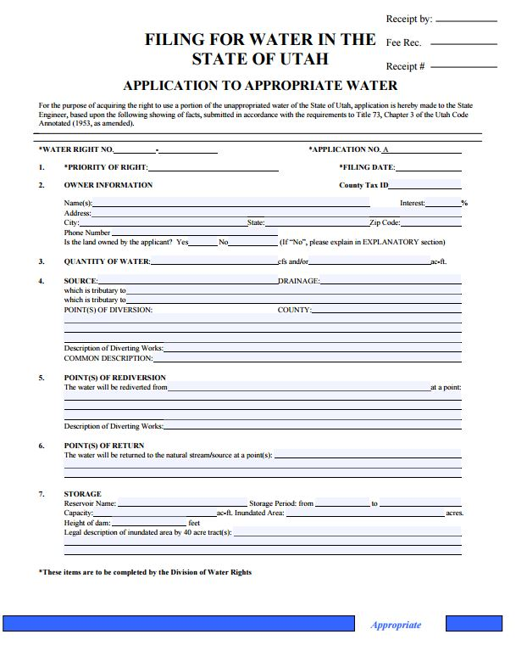
APPLICATIONS:
Application to Appropriate
Change Applications
Temporary Applications
Fixed Time Applications
Exchange Applications

Slide 4
Hell

Slide 5
APPROVAL CRITERIA
APPLICATIONS

Slide 6
APPROVAL CRITERIA:
The Standard by which the State Engineer evaluates applications seeking approval is the “reason to believe standard” outlined in Searle v. Milburn Irrigation Co, (2006)
“placing a fairly low burden on a party seeking approval”

Slide 7
APPROVAL CRITERIA:
Utah Code Ann. §73-3-8
(1)(a) It shall be the duty of the State Engineer to approve an application if there is reason to believe:
(i) there is unappropriated water in the proposed source;

Slide 8
APPROVAL CRITERIA:
Utah Code Ann. §73-3-8
(i) unappropriated water in the proposed source;
Sowards v Meagher (1910)
“…until the actual application of the water is made for a beneficial purpose, no valid appropriation has been effected.”

Slide 9
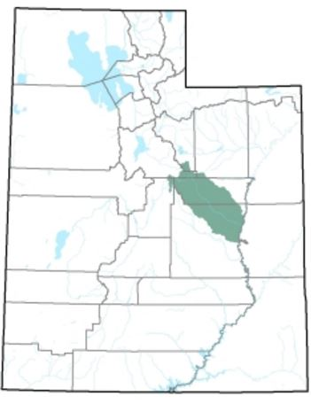
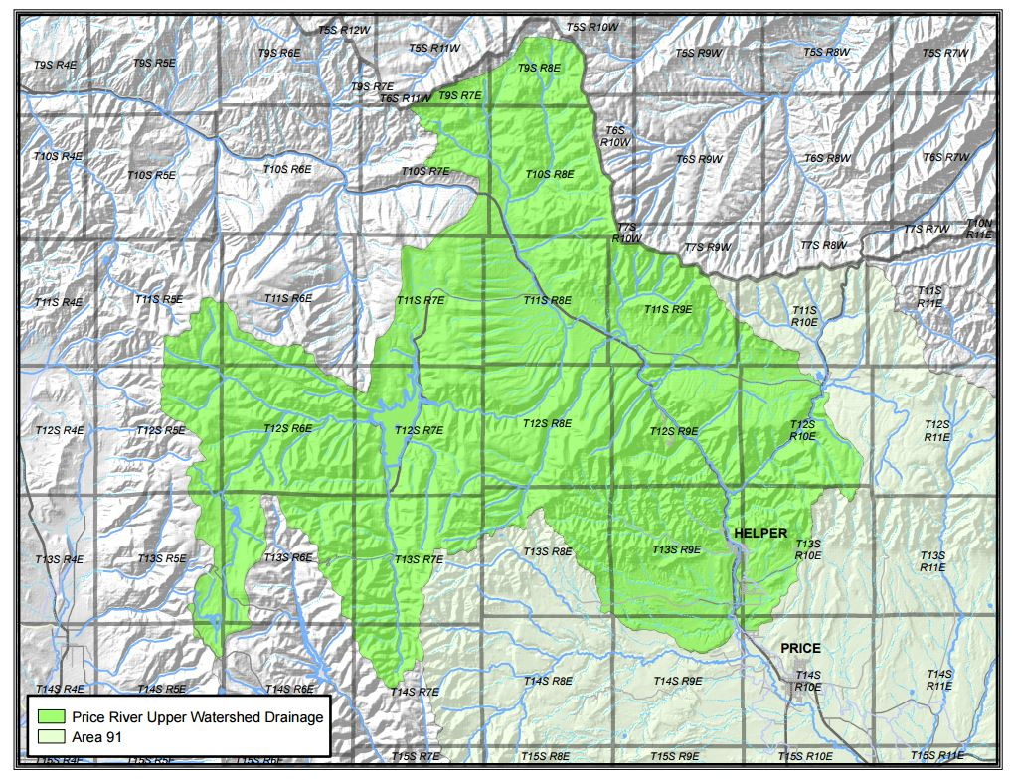
APPROVAL CRITERIA:
Utah Code Ann. §73-3-8
(i) unappropriated water in the proposed source;

Slide 10
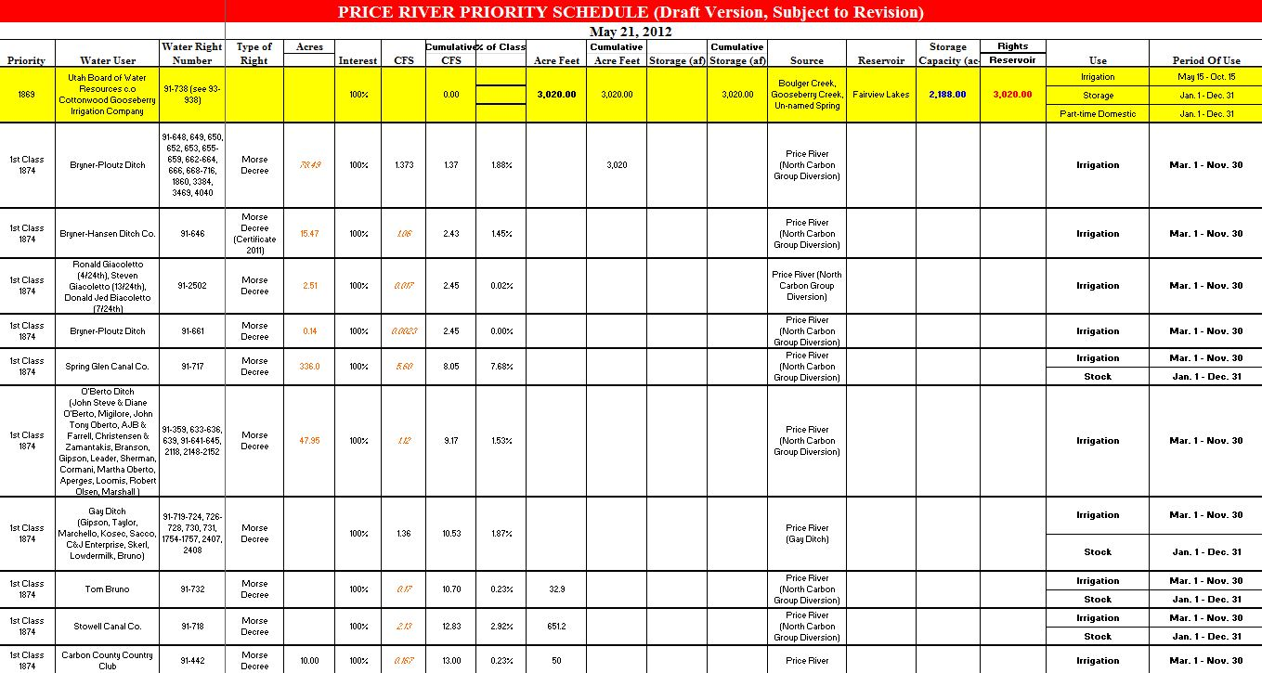
APPROVAL CRITERIA:
Utah Code Ann. §73-3-8
(i) unappropriated water in the proposed source;
Cumulative Perfected Water Rights: 932 cfs & 100,000+ acre-feet
Average Stream Flow: 300 cfs* & 57,000 acre-feet
* May-June

Slide 11
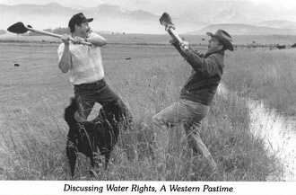
APPROVAL CRITERIA:
Utah Code Ann. §73-3-8
(1)(a) It shall be the duty of the State Engineer to approve an application if there is reason to believe:
(ii) the proposed use will not impair existing rights or interfere with the more beneficial use of the water

Slide 12
APPROVAL CRITERIA:
(ii) will not impair existing rights or interfere with the more beneficial use of the water
For Temporary Change Applications (May 12, 2015):
- Not Advertised / No Hearings -
Utah Code Ann. §73-3-8(4)(b)
(i) approve if reason to believe it will not impair
(ii) deny if reason to believe it will impair

Slide 13
APPROVAL CRITERIA:
(ii) will not impair existing rights or interfere with the more beneficial use of the water
For Permanent Change Applications:
Utah Code Ann. §73-3-3(3)(a)
(ii) except as provided in 73-3-30, the change does not impair an existing right without just compensation or adequate mitigation
Utah Code Ann. §73-3-3(5) (2015)
(a) will not cause a specific existing right to experience quantity impairment

Slide 14
APPROVAL CRITERIA:
For Change Applications:
Utah Code Ann. §73-3-3(1)(b)(i)
Quantity Impairment: means any reduction in water…
(A) diminishing the quantity of water
(B) change in the timing of availability of water
(C) enlarging the quantity of water depleted by the proposed nature of use

Slide 15
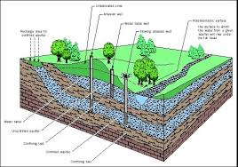
APPROVAL CRITERIA:
For Change Applications:
Utah Code Ann. §73-3-3(1)(b)(ii)
Quantity Impairment: does not mean a decrease in the static level of water in an underground basin or aquifer…if the volume of water necessary to satisfy an existing right otherwise remains reasonably available

Slide 16
APPROVAL CRITERIA:
For Change Applications:
Utah Code Ann. §73-3-3(5)(b)
Applicant has the burden of…rebutting the presumption of Quantity Impairment described in Subsection 73-3-8(6)(c)
Utah Code Ann. §73-3-8(6)(c)
For a period of at least seven consecutive years:
Not diverted from the approved point of diversion; nor
Beneficially used at the approved place of use

Slide 17
APPROVAL CRITERIA:
For Change Applications:
Utah Code Ann. §73-3-8(6)(c)
May not be considered unless raised in a:
Timely protest identifying the rights that may be impaired, or
Written notice from the State Engineer within 90 days from the filing of the application and identifying the rights that may be impaired

Slide 18
APPROVAL CRITERIA:
For Exchange Applications:
Utah Code Ann. §73-3-20
(1) …the original water in such stream, body of water, or reservoir must not be deteriorated in quality or diminished in quantity
(2)(a)(iii)(B) …has a legal interest in the underlying water right used as the basis for the exchange
Often Accomplished via Contract with the Water Right Owner

Slide 19
APPROVAL CRITERIA:
Utah Code Ann. §73-3-8
(1)(a) It shall be the duty of the State Engineer to approve an application if there is reason to believe:
(iii) the proposed plan is physically and economically feasible, unless the application is filed by the U.S. Bureau of Reclamation, and would not prove detrimental to the public welfare

Slide 20
APPROVAL CRITERIA:
Utah Code Ann. §73-3-8
…proposed plan is physically and economically feasible,
Does not require final design, only, that the plan be physically feasible
Does not require the applicants to prove their entire project will be economically feasible by expending all of the require monies at this stage of the process…merely a reasonable probability that the project can be built

Slide 21
APPROVAL CRITERIA:
Utah Code Ann. §73-3-8
(1)(a) It shall be the duty of the State Engineer to approve an application if there is reason to believe:
(iv) the applicant has the financial ability to complete the proposed works

Slide 22
APPROVAL CRITERIA:
Utah Code Ann. §73-3-11
Statement of Financial Ability of Applicants
(for an incorporated company):
Articles of Incorporation
Names and Places of Residence of its Directors and Officers
Amount of authorized and paid-up capital

Slide 23
APPROVAL CRITERIA:
Utah Code Ann. §73-3-8
(1)(a) It shall be the duty of the State Engineer to approve an application if there is reason to believe:
(v) the application was filed in good faith and not for purposes of speculation or monopoly

Slide 24
APPROVAL CRITERIA:
Utah Code Ann. §73-3-8
…filed in good faith and not for purposes of speculation or monopoly
W. Water, LLC v. Olds (2008)
“…the State Engineer concluded that the Original Application was filed for speculation or monopoly because the only proposed beneficial use for the water was a plan to sell it to others. Indeed, the applicants had ‘no lands, facilities, customers, or contracts.’”

Slide 25
APPROVAL CRITERIA:
Utah Code Ann. §73-3-8
(1)(a) It shall be the duty of the State Engineer to approve an application if there is reason to believe:
(vi) if applicable, the application complies with a groundwater management plan adopted under Section 73-5-15

Slide 26
APPROVAL CRITERIA:
Utah Code Ann. §73-3-8
(1)(b) If the State Engineer…has reason to believe that an application will interfere with the water’s more beneficial use for irrigation, municipal and industrial (2015), domestic or culinary, stock watering, power or mining development or manufacturing or will unreasonably affect public recreation or the natural stream environment, or will prove detrimental to the public welfare, the State Engineer shall withhold approval or rejection of the application until the State Engineer has investigated the matter.

Slide 27
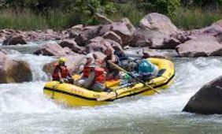
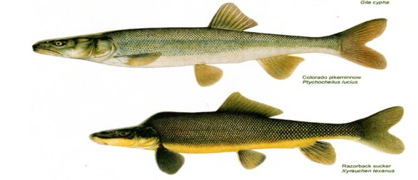
APPROVAL CRITERIA:
Utah Code Ann. §73-3-8
…public recreation or the natural stream environment, or will prove detrimental to the public welfare,
Recreational Opportunities
Riparian Areas / Wildlife
Endangered Species (animal / plant)
Public Health / Infrastructure
Large Taxpayer Funded Water Projects

Slide 28
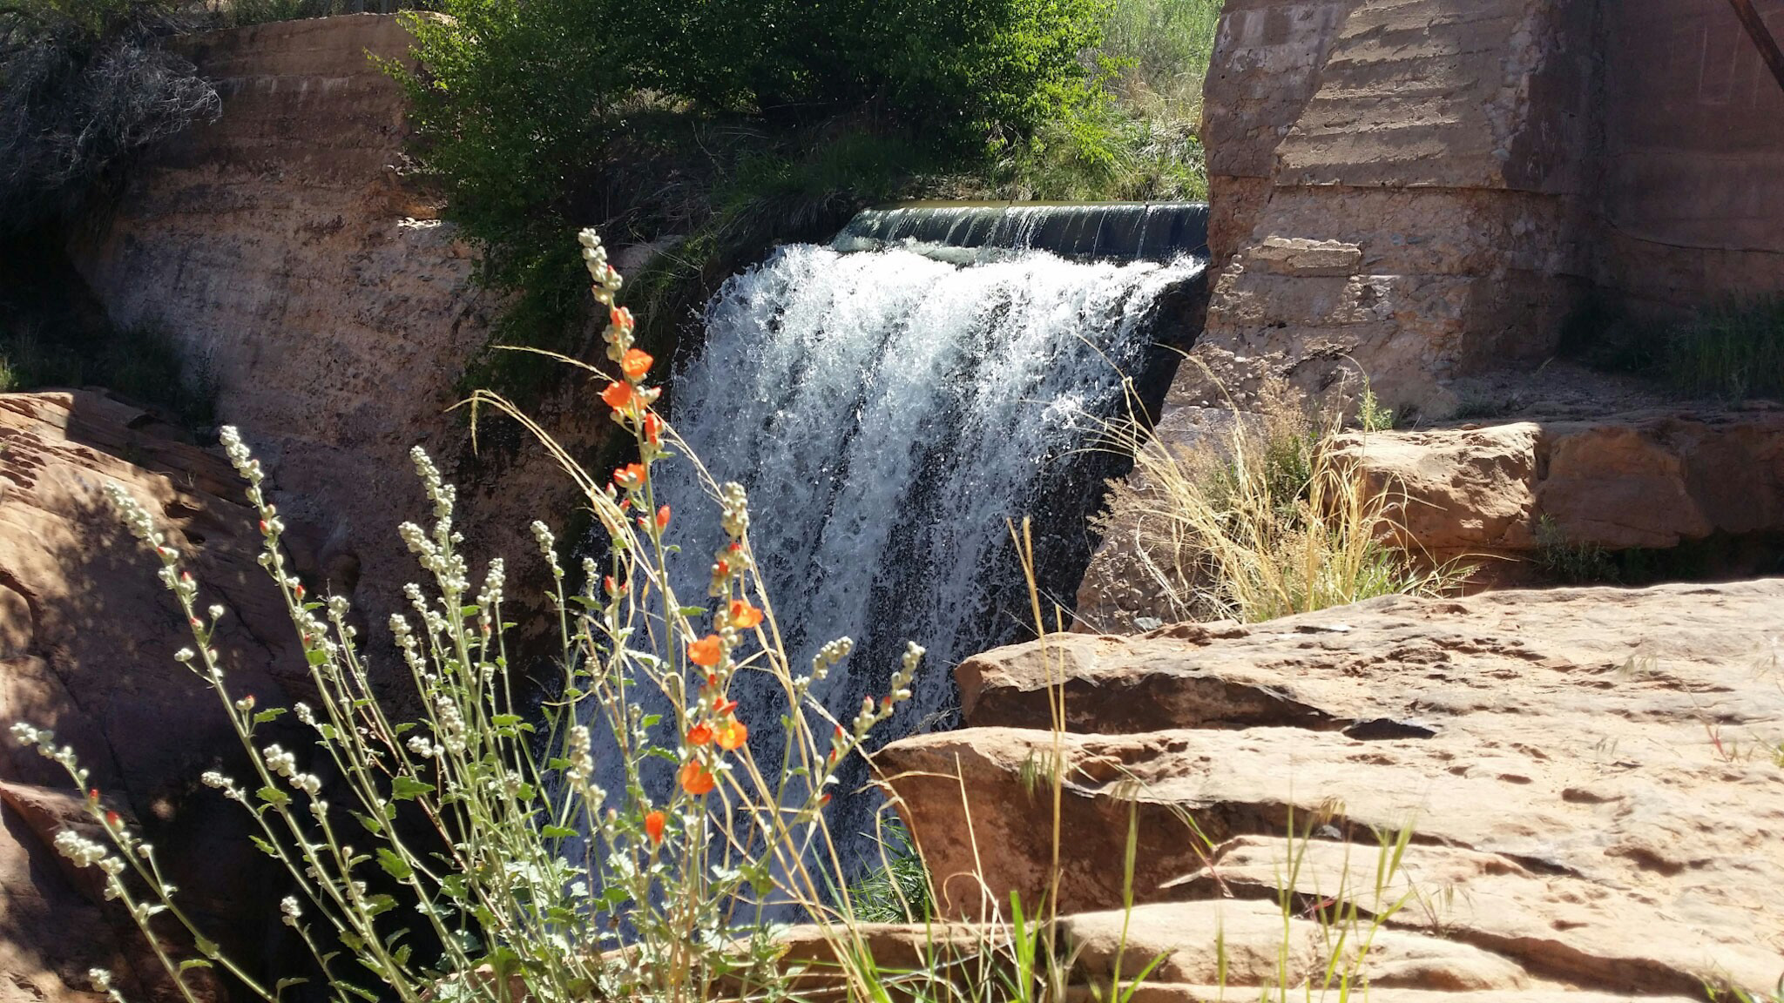
APPROVAL CRITERIA
HEARINGS

Slide 29
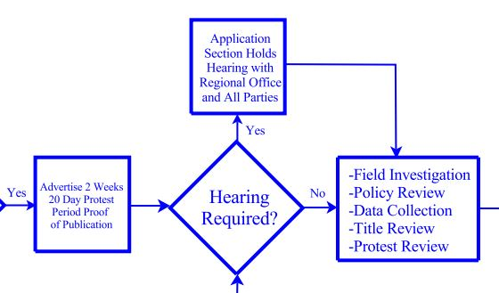
ADMINISTRATIVE HEARINGS:
Purpose – Gather additional information and data relative and pertinent to the application(s) before the State Engineer

Slide 30
ADMINISTRATIVE HEARINGS:
Utah Code Ann. Rule R655-6
May be held if requested in a timely filed protest
May be held at the discretion of the Division even if a protest has not been filed
Informal Proceeding (attorney not required)

Slide 31
ADMINISTRATIVE HEARINGS:
Utah Code Ann. Rule R655-6
Open to all Parties – introduce evidence, examine and cross-examine witnesses, make arguments and fully participate in the proceeding
“Party” – person commencing an adjudicative proceeding, all respondents, all protestants, all persons permitted to intervene, all persons authorized by statute or agency rule to participate as parties

Slide 32
ADMINISTRATIVE HEARINGS:
Utah Code Ann. Rule R655-6
Non-Party participation – person acting as a witness for a party or participating as part of the Division’s investigative and fact finding powers
Such a person is not a party to the proceeding and may not seek judicial review

Slide 33
ADMINISTRATIVE HEARINGS:
Utah Alunite Corporation v. Jones (2016)
“Therefore, although Appellants are aggrieved persons, they lack standing because only persons that are both aggrieved and qualify as parties – aggrieved parties – have standing under section 73-3-14 and UAPA to contest a decision of the State Engineer.”

Slide 34
ADMINISTRATIVE HEARINGS:
Purpose – Gather additional information and data (evidence) relative and pertinent to the application(s):
unappropriated water in the proposed source
not impair existing rights or interfere with the more beneficial use of the water / quantity impairment
physically and economically feasible; not prove detrimental to the public welfare
financial ability to complete the proposed works
filed in good faith and not for purposes of speculation or monopoly
unreasonably affect public recreation or the natural stream environment
the application complies with a groundwater management plan*

Slide 35
APPROVAL CRITERIA:
Utah Code Ann. §73-3-8
(1)(a) It shall be the duty of the State Engineer to approve an application if there is reason to believe:

Slide 36
APPROVAL CRITERIA:
Utah Code Ann. §73-3-8
(1)(c) If an application does not meet the requirements of this section, it shall be rejected.

Slide 37
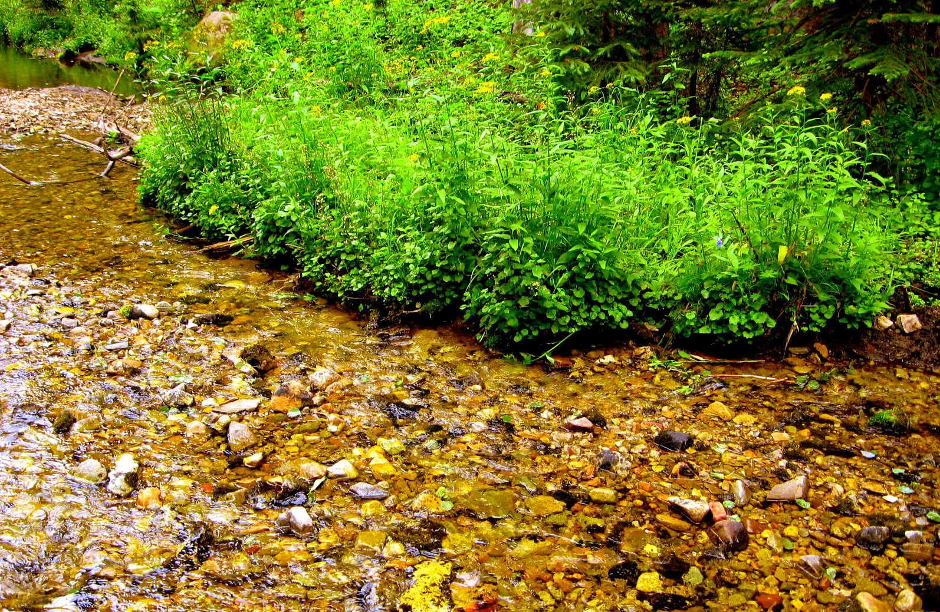
DIVISION POLICY

Slide 38
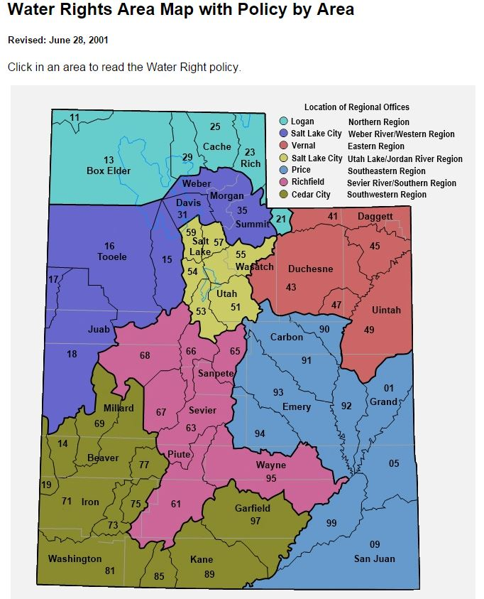
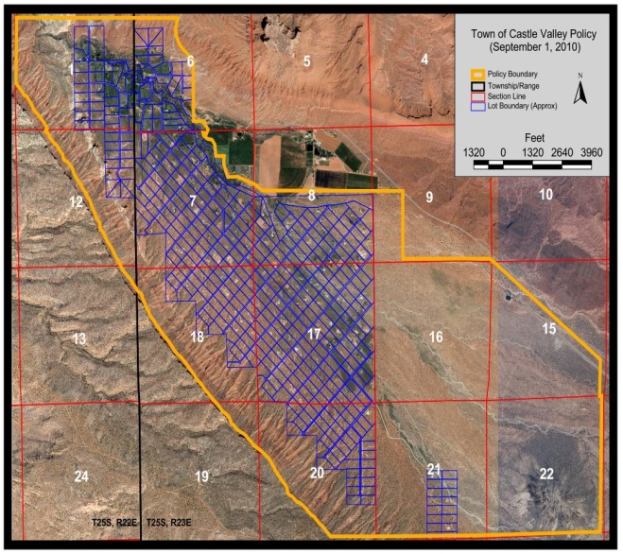
SITE SPECIFIC
POLICY:

Slide 39
SITE SPECIFIC POLICY:
Southeastern Utah
Town of Castle Valley Policy
Colorado River Policy
Endangered Fish Policy
Price River Upper Watershed
Argyle Canyon Policy
Mill Creek Upper Watershed
Willow Basin Watershed

Slide 40
ADDITIONAL CONSIDERATIONS:
Diversion & Depletion
Full Supply Equivalence
Well Abandonment
Maintaining Shares
Retiring Prior Use
Use of Facilities not Owned by Applicant
Municipal Right Considerations

Slide 41
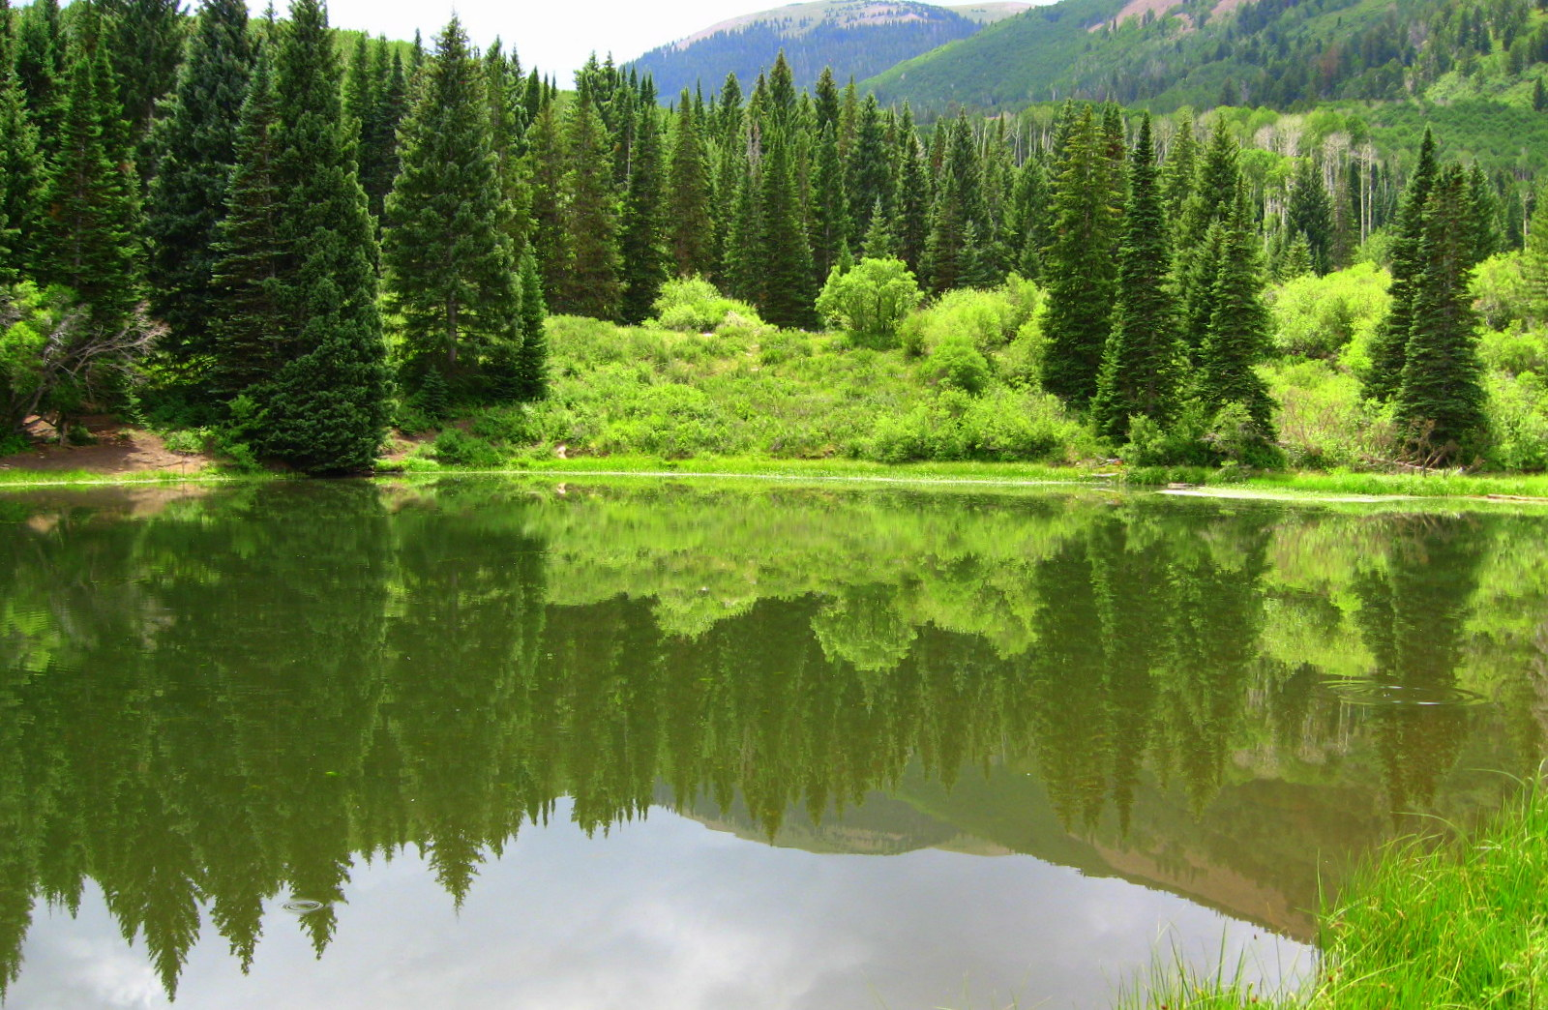
Thank You
– Any Questions?

