Slide 1
Utah Division of Water Rights
Water Wells
Permitting & Regulation
Jim Goddard—April 15, 2016
June 21, 2004

Slide 2
Well Drilling Topics
The Well Drilling Situation in Utah
Well Permitting Mechanisms and Process
Well Renovation, Replacement, & Abandonment Process
Non-Production Well Permitting
Pump Installation Requirements
General Administrative Rules
General Construction Rules
Well Info On Our Website

Slide 3
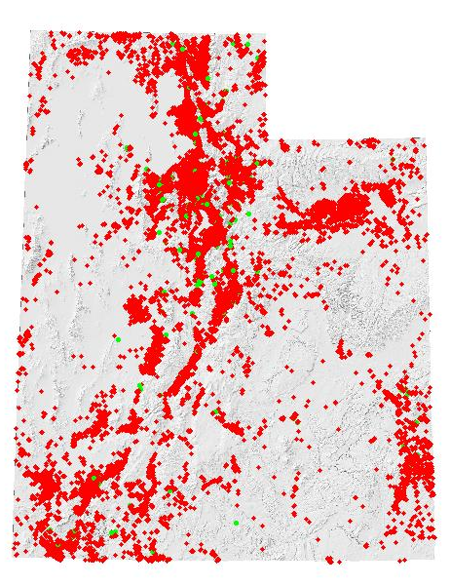
Utah Well Drilling Data
158 licensed well drillers, 138 Licensed Pump Installers, and 228 Registered Operators
566 Non-Production Wells per year – 50% heat pump (down two-thirds)
378 Production Wells per year (48% Air,)
20% Cable Tool, 18% Mud)
72% DOM/IRR/STK Wells
14% Irrigation Wells
9% Stockwater Wells
3% Public Supply Wells
2% Commercial/Industrial Wells
70% of water wells were 4-6 inch diameter

Slide 4
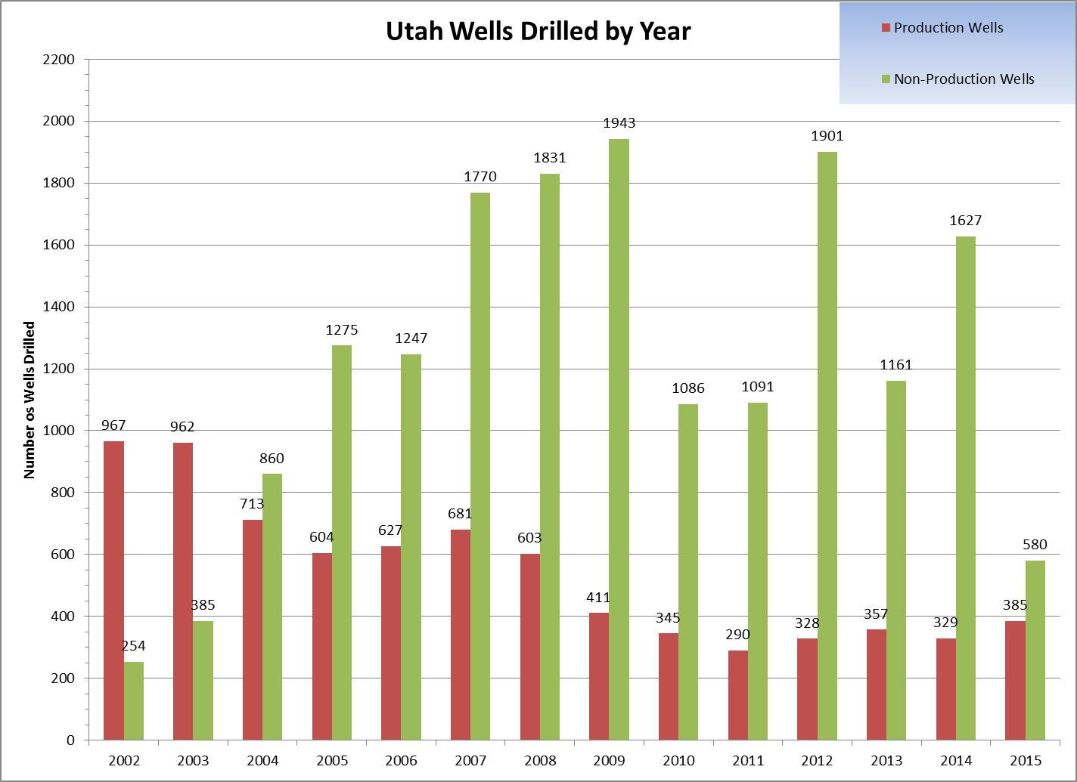

Slide 5
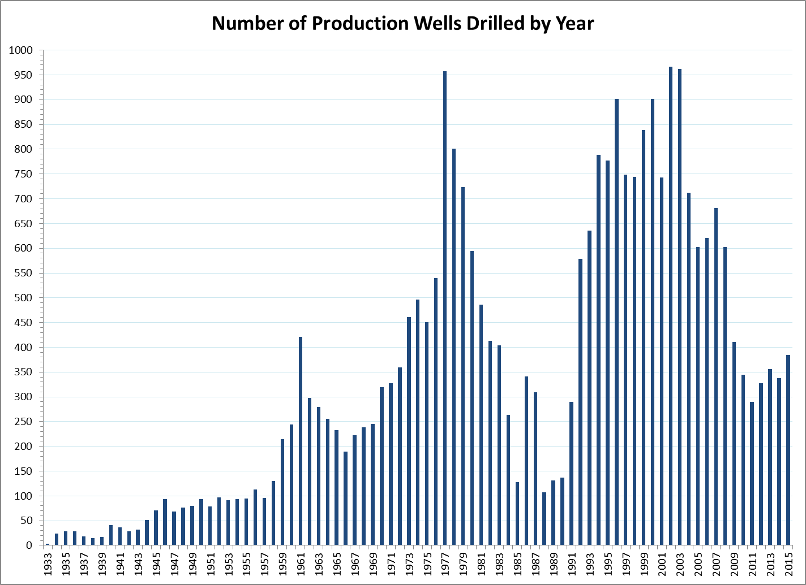

Slide 6
Common Utah Drilling Methods
Mud Rotary
Cable Tool
Air Rotary
Down-hole Hammer
Drill-through Casing Drivers
Under-reamer Systems
Dual Rotary
Reverse Air Rotary
Flooded Reverse Rotary
Other Methods (Jetting, Direct Push, Sonic, Percussion Hammer, Hollow Stem Auger, Coring, Horizontal, Bucket Auger, etc.)

Slide 7
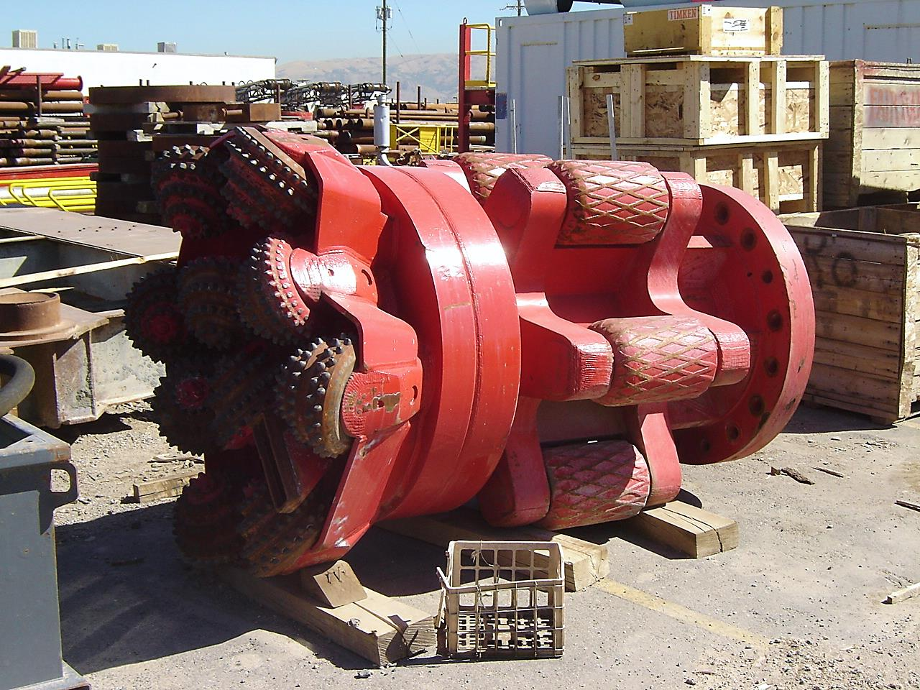
Activity Permitting
Well Drilling

Slide 8
Well Permitting Mechanisms
Application to Appropriate
Change Application
Exchange Application
Temporary Change Application
Provisional (Rush Letter)
Well Renovation
Well Replacement
Non-Production Well
Test, Monitor, Cathodic, Heat Pump, Dewater, etc.

Slide 9
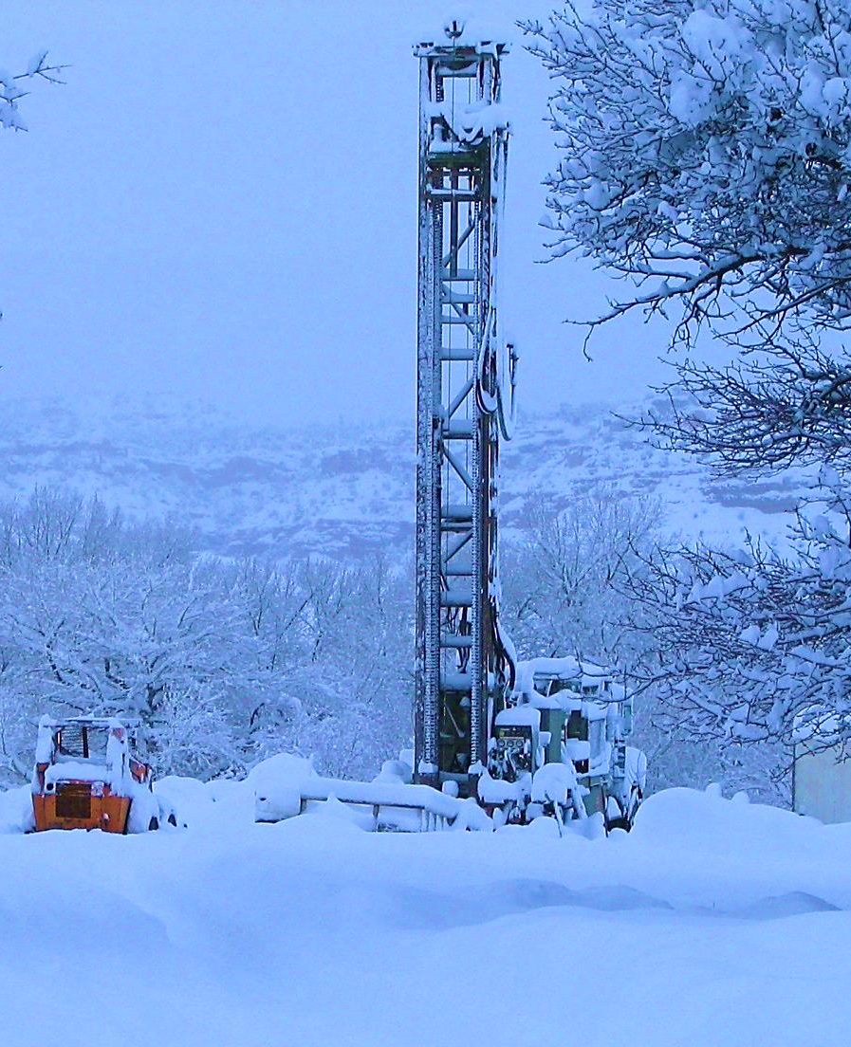
Application Process New Water Production Wells
Approval (New, Change, Exchange)
Application
Review & Advertise
Protest Period
Hearing
Memo Decision, Approval letter, Start Cards
Durations varies (weeks to months…or longer)

Slide 10
Well Drilling Fees
Fee is based on quantity of water right for Production Wells (see table)
No fee for Non-production well permits
No fee for permit to renovate and replace a well

Slide 11
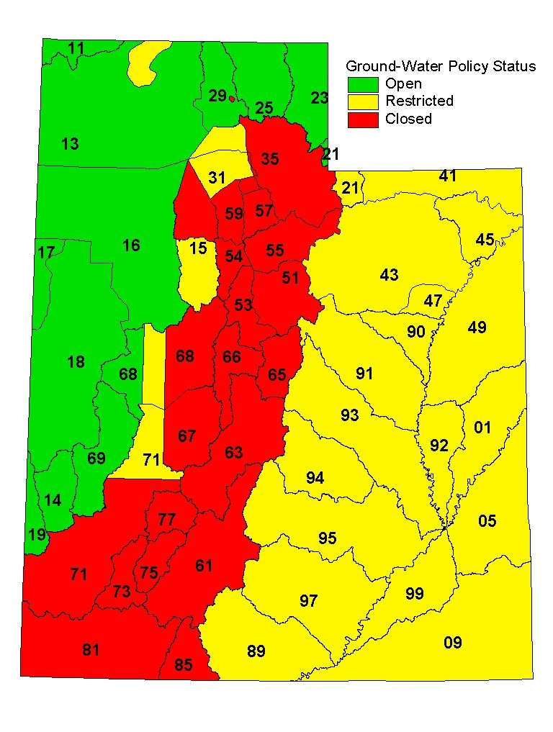
State Engineer’s
Water
Appropriation Policy

Slide 12
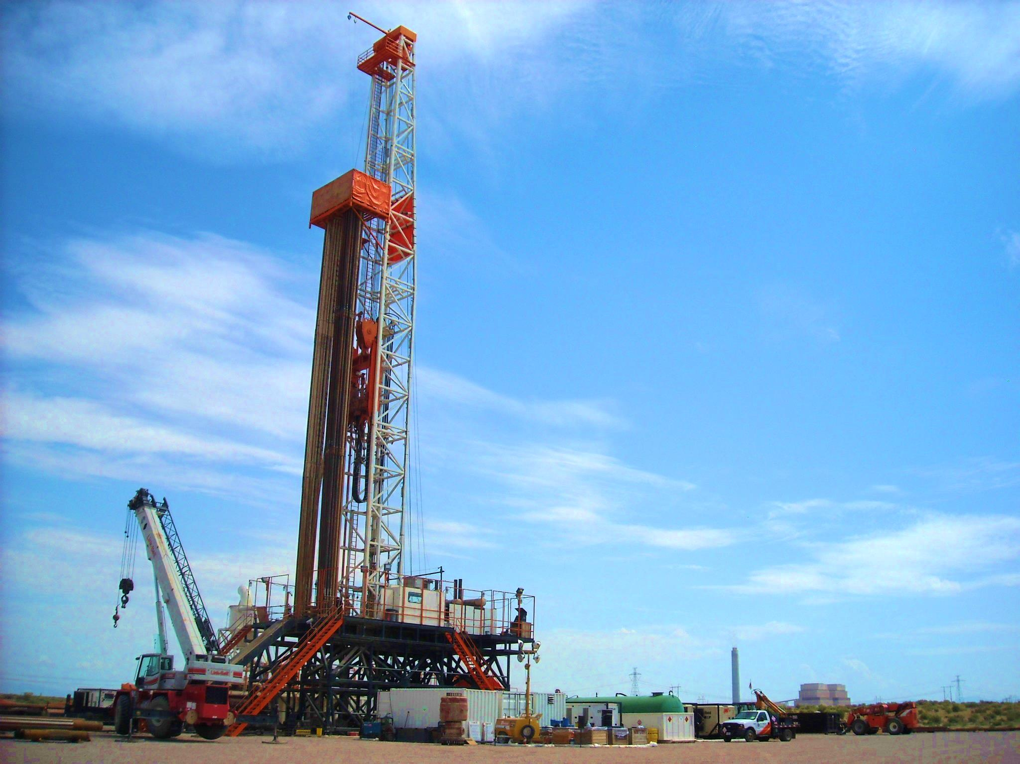
Application Process
When and what forms are filed

Slide 13
Application to Renovate
Application to Renovate An Existing Well
Modification to well (deepen, liners, screens, perforations, casing repair, pitless, seal, etc.)
DOES NOT grant approval to replace
No Application fee
Title and ownership must be current
Allows for repair, renovation, and/or deepening
Need separate application to replace well

Slide 14
When Do You Need a Renovation Permit
Renovate Permit Needed
Deepening
Well Repair/Renovation
Anytime the well itself is modified
Renovate Permit Not Needed
Cleaning
Development
Disinfection
Testing
Pump Work
Still needs to be done by a licensed Driller or Pump Installer
Still need to submit a pump log to report this information

Slide 15
Application for Well Replacement
“Application to Replace an Existing Well”
Replacement well must be within 150 feet of old well for this process
Over 150 feet goes to change application process
Owner responsible to have licensed driller abandon existing well
No Application fee
Title and ownership must be current
Abandonment of existing well a condition of approval
Well log and abandonment log are tracked and both must be returned by Driller

Slide 16
Well Abandonment Process
To abandon means to seal the well bottom to top with approved sealing materials
A well must be abandoned by a licensed well driller
Temporary versus Permanent Abandonments
When a well is replaced, the old well must be abandoned as a condition of approval
For a stand-alone abandonment, a permit is not required
However, Water Rights must be notified prior to abandonment by the licensed driller
The licensed driller submits a certified abandonment log to Water Rights which becomes part of the water right record

Slide 17
Application for Non-Production Wells (NPW)
Types of wells included
Test Wells (No WR Application filed)
Provisional (Rush) wells do NOT use this form
Cathodic Protection Wells (>30')
Closed Loop Heat Exchange Wells (>30')
Monitor Wells (>30')
Approval to construct (NPW Form; No Fee)
Given by Well Drilling and/or Regional Offices
Up to 14-day review
NPW Public Listing

Slide 18
Provisional Wells A.K.A. “RUSH LETTER”
Permission to drill before WR-related application approved
Granted at owners risk
Authorization to drill, construct, and test, but not put into production or beneficial use
Linked to WR application and processed through WR database
Owner files application (e.g., new, change, exchange) first, then submits letter request or non-production well application for Provisional Well to start drilling
Requests reviewed and approved by Regional Engineer

Slide 19
Utah Code Section 73-3-5(4) provides that the state engineer may issue a temporary receipt to drill a well at any time after the filing of an application to appropriate water therefrom... provided in the judgment of the state engineer there is unappropriated water available in the proposed source and there is no likelihood of impairment of existing rights.
Water right process must still be followed
Written request with or after WR application
Approval to drill, construct, and test, but cannot divert the well water or put to beneficial use until after the WR application has been approved

Slide 20
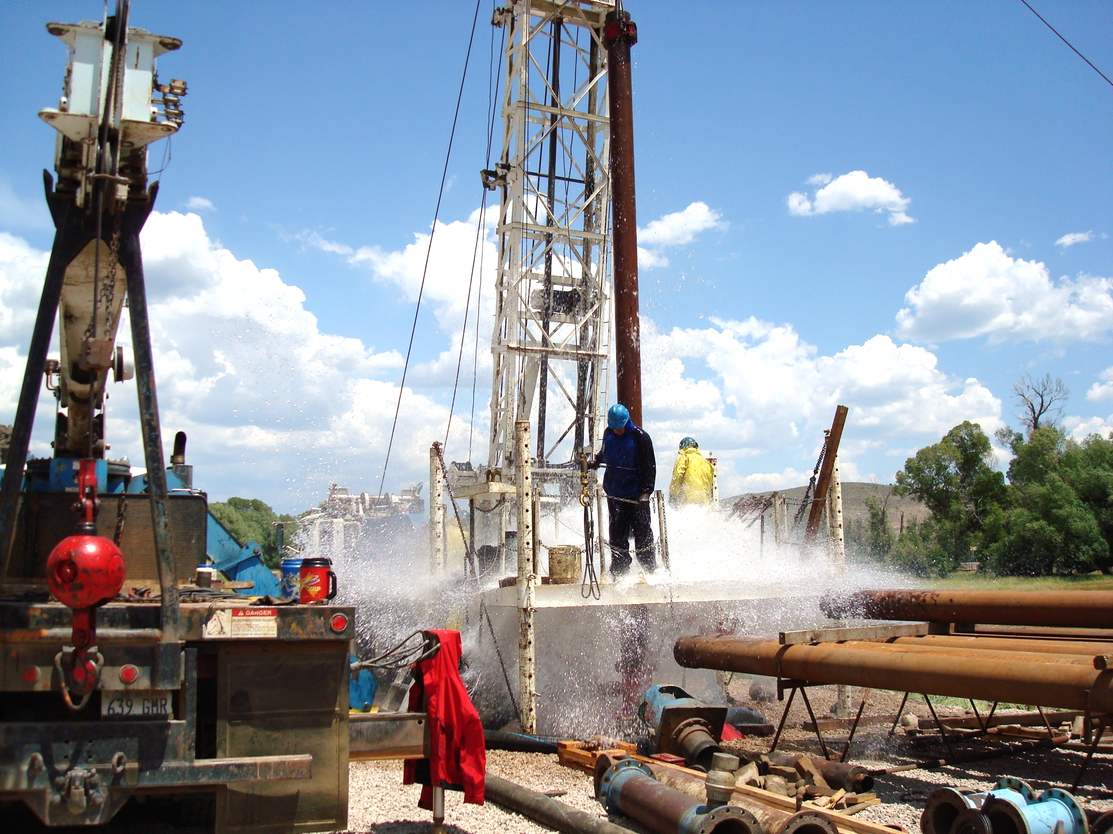
Well Drilling Rules

Slide 21
Administrative Rules for Water Wells R655-4 Utah Administrative Code
“Provide order and certainty in the beneficial use of Utah’s water”

Slide 22
Scope of Rules Regulated Wells/License Required
Production Wells Greater than 30 feet deep
Permitted through WR Process in WR database and associated with a WR#
Domestic
Irrigation
Stock
Public supply
Commercial/industrial
Open Loop Heat Exchange Wells
Well Renovation & Replacement
Non-Production Wells (NPW) greater than 30 feet
Permitted through NPW process in well drilling database and associated with a NPW number (aka M00 #)
Test Wells
Monitoring Wells
Cathodic Protection Wells
Closed Loop Heat Exchange Wells
Misc. Wells (Piezometers, inclinometers, anode)

Slide 23
Wells Excluded from the Rules
Any well less than 30 feet
IMPORTANT: Production wells less than 30 feet deep still need a Water Right
Geothermal Wells (Regulated by R655-1 UAC)
Exploratory or geotechnical borings
Structure monitoring wells if aquifer not impacted
Dewatering wells if aquifer not impacted

Slide 24
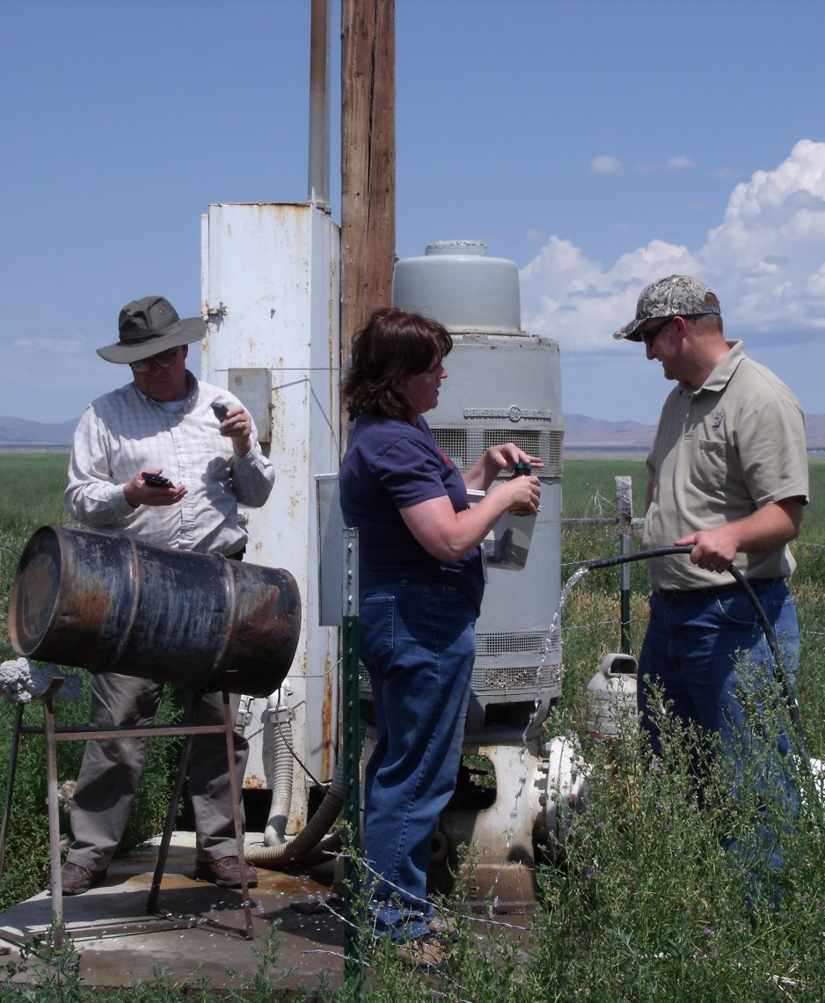
“Well Drilling” Regulatory Definition
Well drilling means the act of drilling, constructing, repairing, renovating, deepening, cleaning, developing, or abandoning a well
Pump installation and repair is now regulated by the Rules

Slide 25
Administrative Rules
License required for drillers and pump installers
Experience, testing, bonding, continuing education, renewal
Registration required for rig operators
Violations, Infractions, and Enforcement
Removing Drill Rig from Site
Requirements During Construction
License No. or Company name on rig
Licensed driller or registered operator on site
Requirements During Construction
License No. or Company name on rig
Licensed driller or registered operator on site
Reporting Requirements
Start Card Submitted for starting regulated work
Well log - 30 days after completion of well
Specific log for each well
Pump Logs
Abandonment reports
APPLICANT CARD

Slide 26
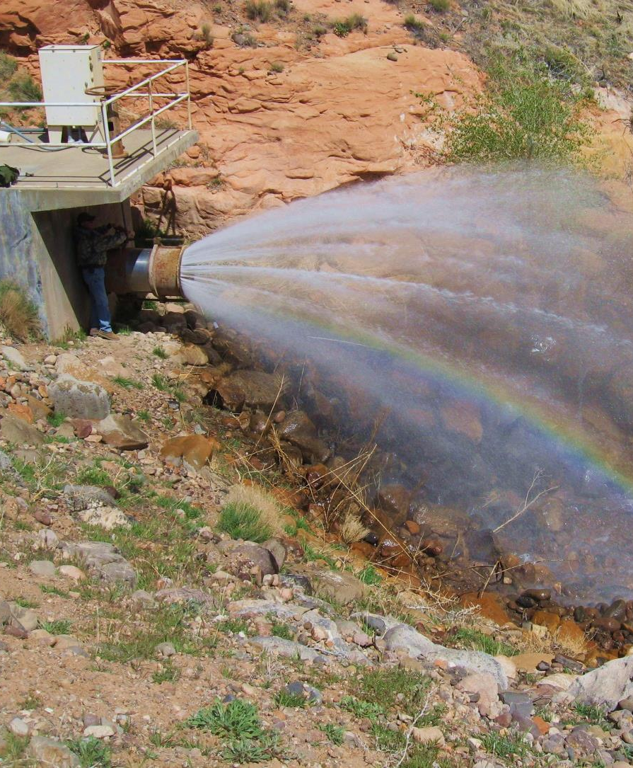
Pump Installation Rules
License required of those doing work professionally for compensation
Doing own work on own property on own well does not require a license
No permits or start cards required
Required reporting to include a Pump Log

Slide 27
Additional Permitting for Public Supply Wells
Regulated through the Division of Drinking Water (R309-515)
Project Notification
Preliminary Evaluation Report/Drinking Water Source Protection Plan
Preapproval of Plans/Specifications
Drilling/Construction Materials and Methods
Certified Sealing
Pump Testing and Water Quality
Disinfection
Submitted by Licensed Driller, Professional Engineer, or Professional Geologist
Fines for submitting this info after the fact

Slide 28
Construction Requirements

Slide 29
Main Components
Well Casing, Joints, Screens, & Perforations
Surface and Interval Seals
Formation Stabilizers – Gravel (Filter) Pack
Aquifer Protection (Fluids, Chemicals, LCMs, Cross-contamination, Disinfection)
Surface Completion
Special Wells & Monitoring Wells
Deepening, Rehab, and Renovation
Well Abandonment
Pump Installation and Repair

Slide 30
Well Drilling Web Features www.waterrights.utah.gov

Slide 31
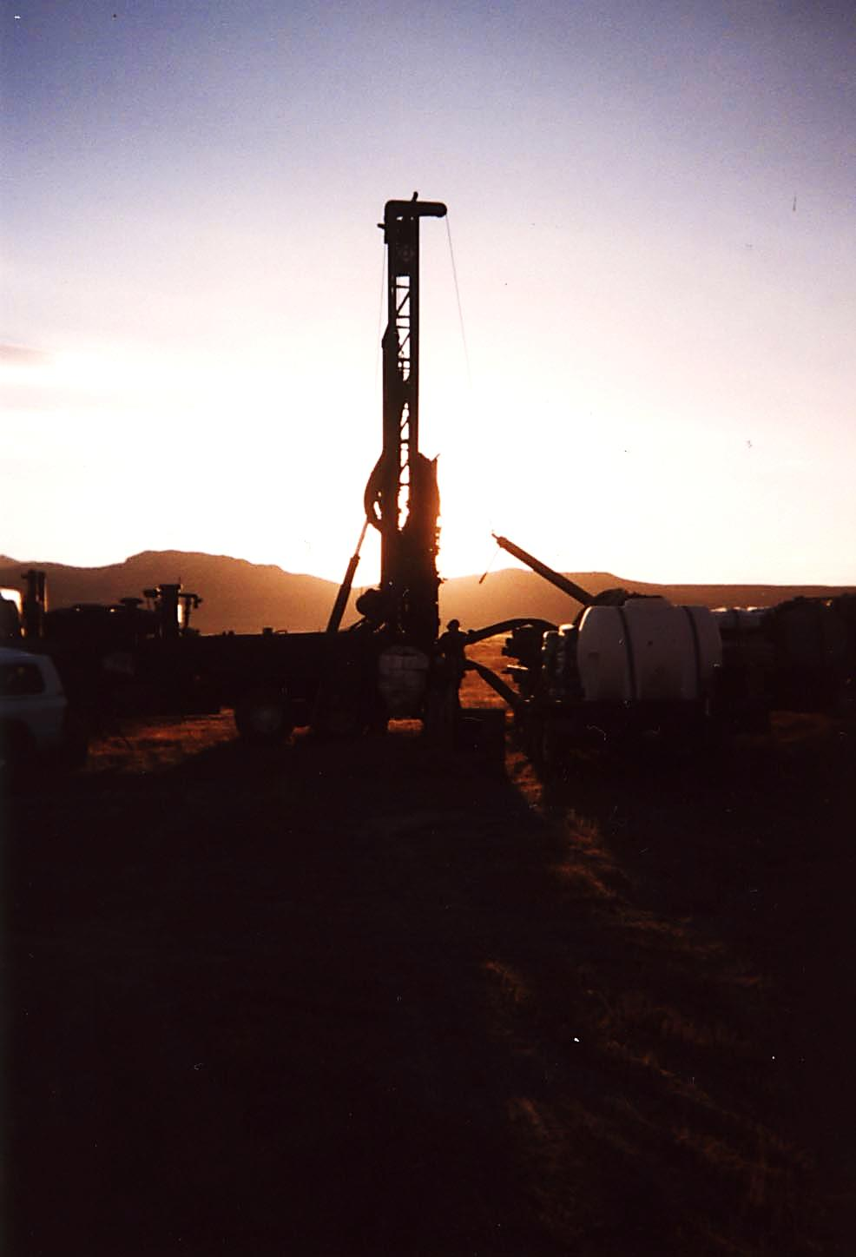
QUESTIONS?
Jim Goddard
Office: 801-538-7314
Cell: 801-505-8677
Email: jimgoddard@utah.gov
Web: waterrights.utah.gov
“When the well is dry, we know the worth of water” …B. Franklin

