Slide 1


Utah Division of Water Rights
Public Water Suppliers
RWUA Training—April 2017
S. Ross Hansen, P.E., L.S.
Utah Lake/Jordan River Regional Engineer
June 21, 2004
Notes:
My name is Ross Hansen
The slide in your book shows me as the Weber River/West Desert Regional Engineer
I have taken a new position and now serve as the Utah Lake/Jordan River Regional Engineer
My topic is public Water Suppliers
Not a big fan of speaking in public, but I’m happy to do this because I’m convinced that the more knowledge you have; the easier my job becomes.
I want to make sure you gain the knowledge you are seeking - so I want to present in an interactive way; a sort of “directed” dialogue - if you will
Rather than show you a bunch of slides and have you hold your questions until the end;
I want invite you to ask questions as we go and I will try to respond; if I don’t have the answers - most likely one of my colleagues will have the answer. This kind of format makes it difficult to manage the time, but you gaining knowledge is more important than sticking to a time schedule.

Slide 2
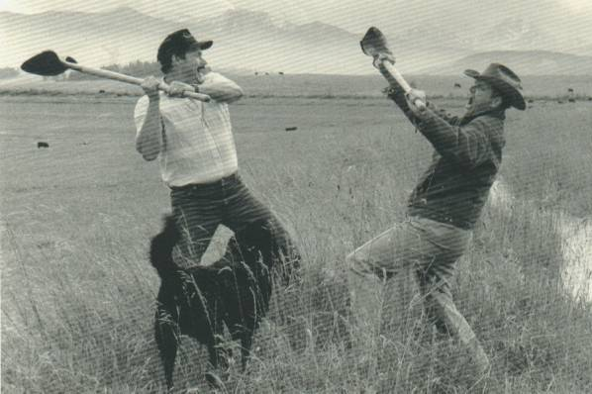
The Old Way To Handle Water Disputes May Be The Better Way?
Notes:
To try and loosen you up I thought I would start with a photo:
I’m sure you have all seen this picture a thousand times
I don’t condone violence in any way, but:
Back in the day you sorted out your disagreements at the headgate of the ditch;
Today you call your attorney and your attorney calls me;
The next thing you know we’re tied up in a multi year legal battle

Slide 3

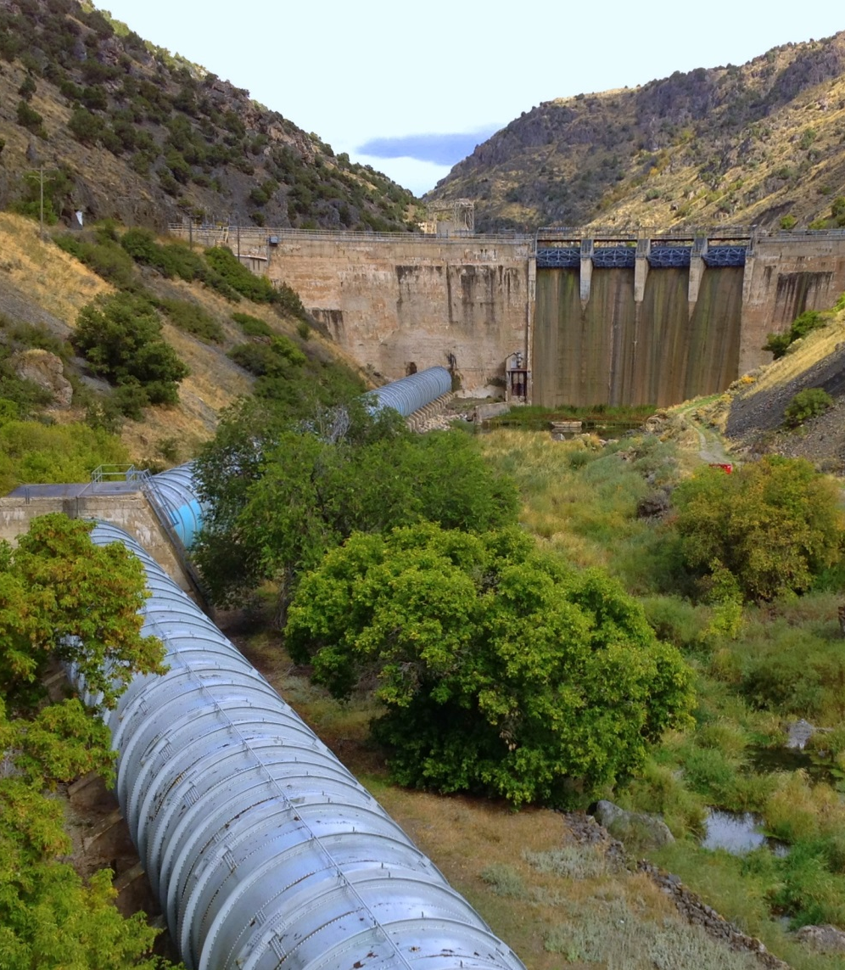
Overview
What is a Public Water Supplier? (PWS)
How are PWS water rights treated differently than other water rights?
  Extensions of time to file proof
  Nonuse/forfeiture
  Proof and Certification
Example
Notes:
How many of you represent or work for a PWS?
Provide consulting services for a PWS?
How many don’t know what a PWS is?
Ok- we’re going to define what a PWS is
We’re going to explore treatment of PWS within 3 different administrative functions of the state engineer.

Slide 4
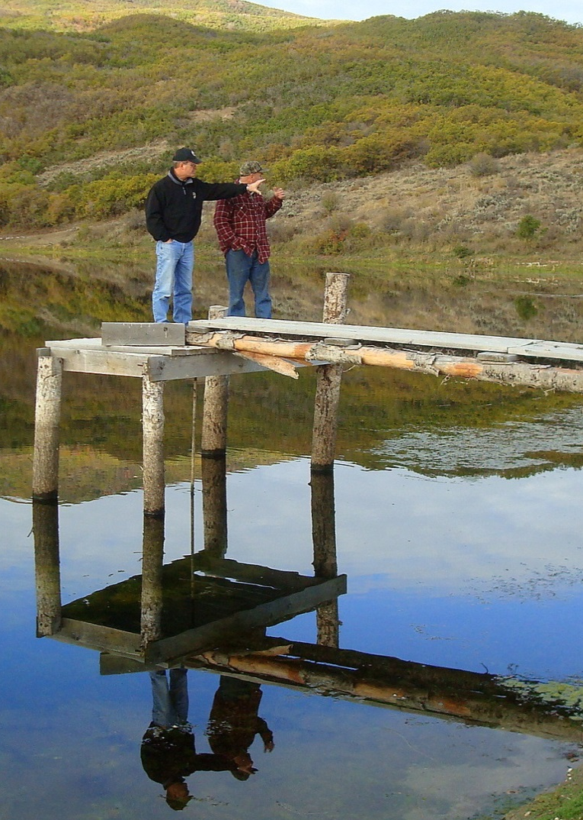
Vocabulary/Acronyms
Acre-foot - An acre of land 1’ deep water
CFS - Cubic Feet per Second
POD – Point of Diversion
S.E. – State Engineer
WR – Water Right
PWS– Public Water Supplier
Notes:
Because I find myself using acronyms terms that maybe some people are not familiar with I always like to throw up a slide that defines them prior to a presentation.
Helps stop a lot of weird looks while I’m up here.
Take a quick look at each of these because they will show up on my slides

Slide 5

Public Water Supplier
How Do I Become One?
Act like one
  Serve water to the public
  Be a public agency or be publically accountable
  Report to the Division PWS water use program
  Claim entitled provisions in requests/applications
There is no application process or official list
Notes:
Those that didn’t raise your hand when I asked how many were affiliated with a PWS; might be wondering how do I become a PWS?
All though there is no application to become a PWS; The Statute directs the SE as to what entities qualify as a PWS

Slide 6
A Public Water Supplier (PWS):
Statute Section 73-1-4(1)(b)
(i) Supplies water, directly or indirectly, to the public for municipal, domestic, or industrial use; and
(ii) is:
(A) a public entity;
(B) a water corporation, as defined in Section 54-2-1, that is regulated by the Public Service Commission;
(C) a community water system:
(I) that:
(Aa) supplies water to at least 100 service connections used by year-round residents; or
(Bb) regularly serves at least 200 year-round residents; and
Notes:
Apologize for cluttered slide
Make note that this is a copy of the section of the code
But this section identifies what types of entities qualify for special treatment of their water rights
There is important information on this slide that will be part of the exam

Slide 7
A Public Water Supplier (PWS) is:
Statute Section 73-1-4(1)(b) (cont.)
(II) whose voting members:
(Aa) own a share in the community water system;
(Bb) receive water from the community water system in proportion to the member's share in the community water system; and
(Cc) pay the rate set by the community water system based on the water the member receives; or
(D) a water users association:
(I) in which one or more public entities own at least 70% of the outstanding shares; and
(II) that is a local sponsor of a water project constructed by the United States Bureau of Reclamation.
Notes:
Less than a handful of entities qualify for PWS treatment under subsection D
Provo River Water User’s Association is an example

Slide 8
What’s Different With PWS Water Rights?—Extension of Time
Water right(s)/portion owned by non PWS entities:
  Must show due diligence in completing works or
  Show reasonable cause for delay.
  No extension beyond 50 years to complete works.
Statute section 73-3-12(2)(h) PWS water right:
  Simply holding an approved application for future public needs is reasonable due diligence for 50 yrs
  Can be extended beyond 50 years with a 40 yr plan.
Notes:
Now we got the statutes out of the way.
Let’s talk now about the special treatment that PWS receive when it come to 3 different administrative functions
In order to understand the special treatment granted to PWS –
I’ve found it helpful to compare and contrast how a water right held by JOE PUBLIC is administered and how a PWS’ water right is administered.
Let’s start with Extensions of time
Start with– due diligence –or – reasonable cause for delay
Just to be clear – what we’re talking about here is – an application (whether it be a change/exchange/of an appropriation) has been approved and the applicant working on placing the water to beneficial use so he/she can submit proof.

Slide 9
Content of PWS 40 Year Plan
73-1-4(2)(e)(f)
Show future 40 year demand for water by:
  Showing projected population growth within service area.
Show works constructed and/or expenditures.
Should be WR specific
Service area is:
  Presently areas served by water distribution facilities
  Area expands as distribution system expands
  Thus: It is the geographical area that PWS agrees to serve
Notes:
Let’s dig in to 40 year plans
Now remember we’re talking about un-perfected rights that need more time to submit proof

Slide 10
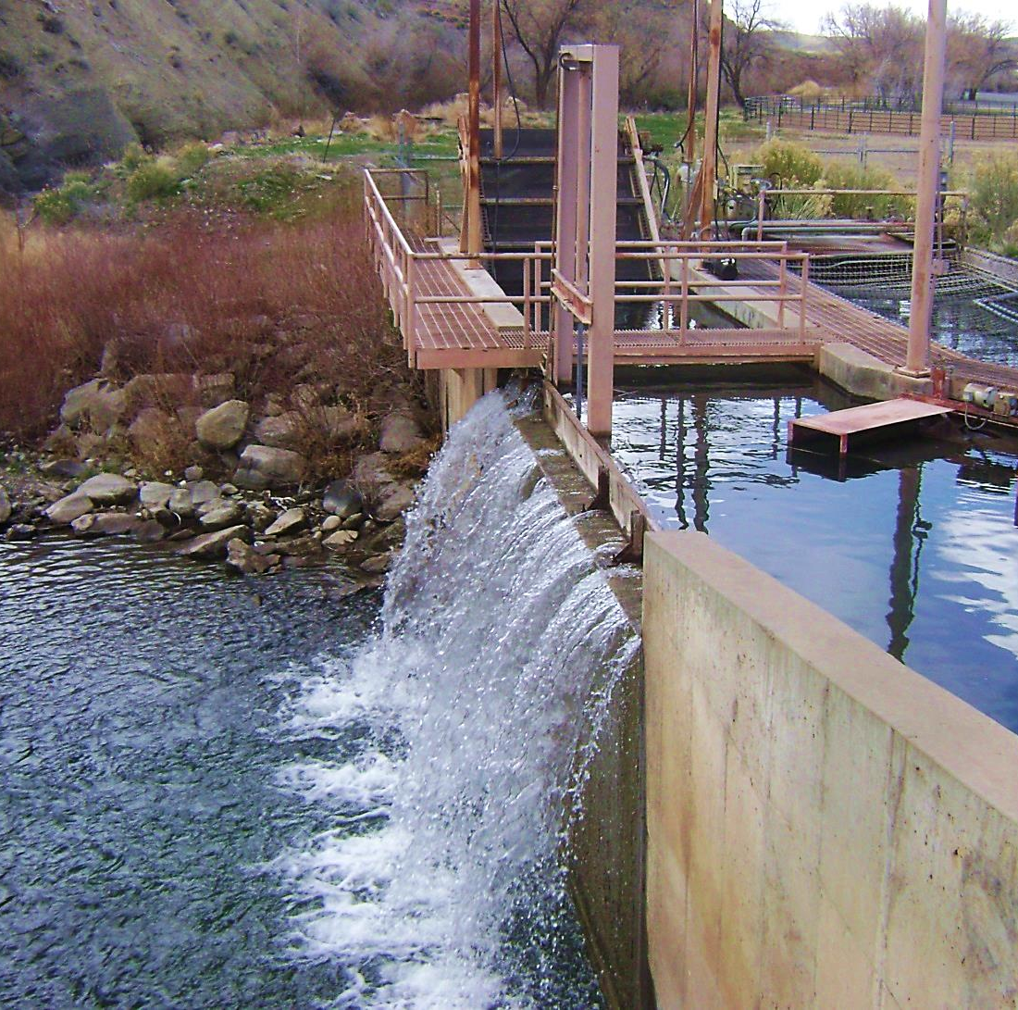
Content of PWS 40 Year Plan, Continued
Tabulation of already certificated WRs compared to future demand. Demonstrating need for extension of time.
Plan should be dynamic and constantly updated.
Should be WR specific
Notes:
Give example of failed 40 year plan- City shall remain nameless-
18,000 ac-ft projected need – 20,000 ac-feet perfected
40 year plans should be a dynamic plan constantly being updated

Slide 11
What’s Different With PWS Water Rights?—Forfeiture
Water right(s)/portion owned by non PWS entities are subject to forfeiture if not used for a period of 7 years.
Statute section 73-1-4(2)(e)(vii) exempts water rights owned by PWS from forfeiture.
  If PWS acquires right after May 2, 2008
    A change app must be approved to move the water to the PWS to protect from nonuse.
Notes:
Now we’re talking about a water right that is perfected – not one where the applicant is trying to proof up on.
If the PWS acquired title to a water right prior to May 2, 2008 we’re are not going to look at non-use issues.

Slide 12
What’s Different With PWS Water Rights?—Proof
Historically
Presently
PWS proofs consisted of showing the capacity of the well.
  Example: water right was for 5 cfs
  Drill well - install 5 cfs pump - submit proof.
PWS proof must show:
  Capacity of well
  An accounting of all water rights which include the well as one of its POD
  A comparison of water use reported/diverted with quantity of water being proofed.
  Service area not specific place of use.
Notes:
Many phone calls from PWS with proofing questions
Always remember, Beneficial Use is the limit and measure of a right.
Example both written and numeric on next couple of slides

Slide 13

Notes:
This video reminds me of what its like to work at the Division of Water Rights- It’s like a game of musical chairs
Watch the lady in the Green Shirt- You just can’t get ahead.

Slide 14
What’s Different With PWS Water Rights?—Proof (Example)
City has 2 water rights with right to divert 4 cfs and 5 cfs totaling 6500 ac-feet volume.
Well capacities: Well A= 6 cfs; Well B= 5 cfs.
2 wells -water reporting info. diversion equals 2000 ac-feet annually.
City buys farmer’s 600 ac-feet WR and files municipal change application to divert water from city’s 2 wells.
When city files proof what can be certificated?
Answer = Nothing – 0 ac-feet.
Notes:
Multiplied by the number of seconds in a year = 6500 ac-ft
Great producing wells; have the capicity to pump 6 and 5 cfs
Ag to municipal change
Ask how much water from the farmer’s right can be certificated????
Let’s look at the numbers…..

Slide 15
PWS Proof (Example)
Notes:
Highlight the fact that wells do have the capacity.
Beneficial use is what matters.

Slide 16
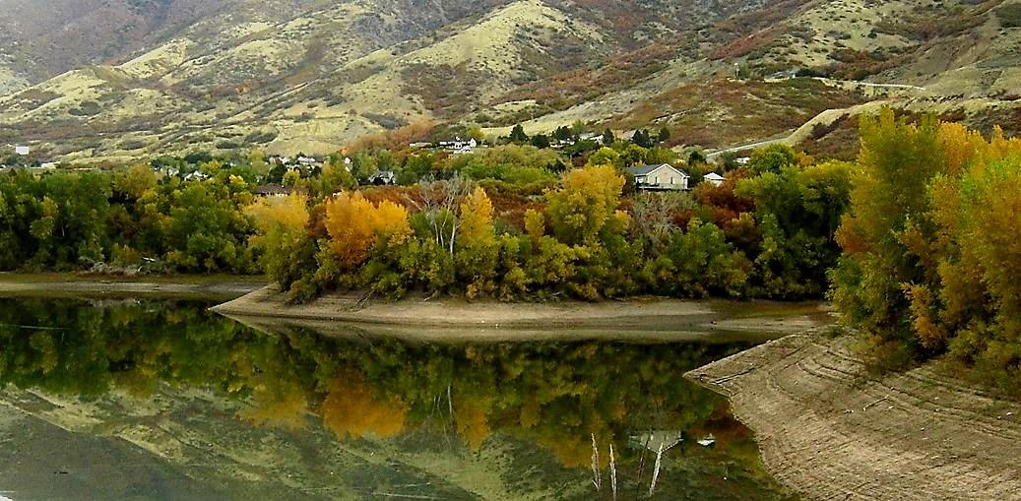
PWS Service Area
The geographic area wherein
a PWS agrees to serve water.
No Change Application is required if/when PWS expands its distribution facilities
Notes:
Service area is dynamic and can expand.
Frequent Phone calls from PWS as to whether they need to file a change application- NO

Slide 17
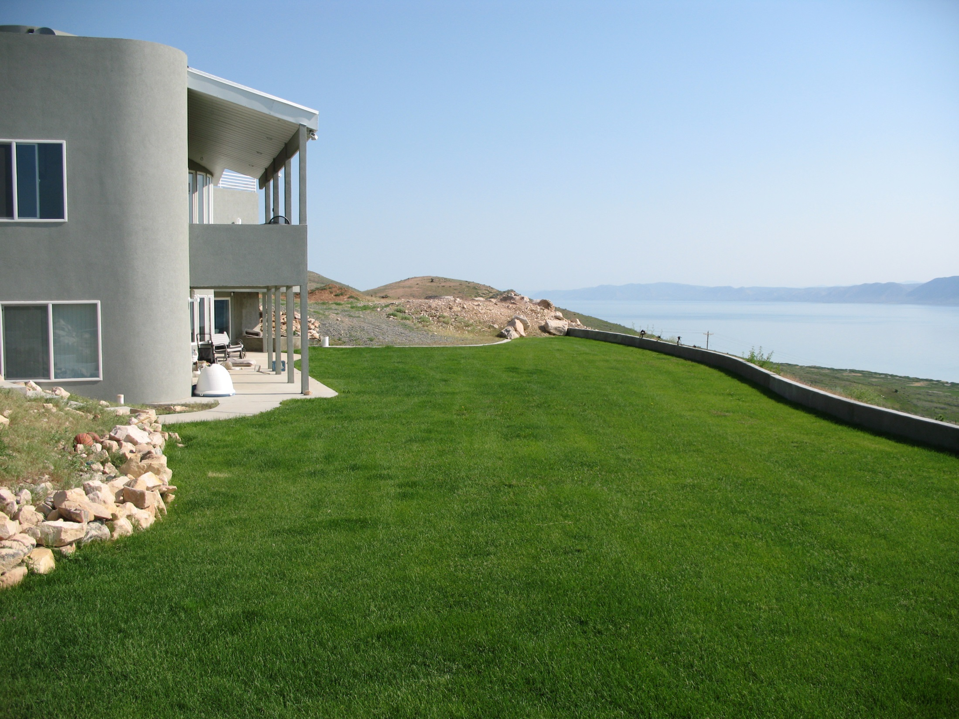
www.waterrights.utah.gov
Where to get more information
Notes:
Taken by Carl Mackley

Slide 18
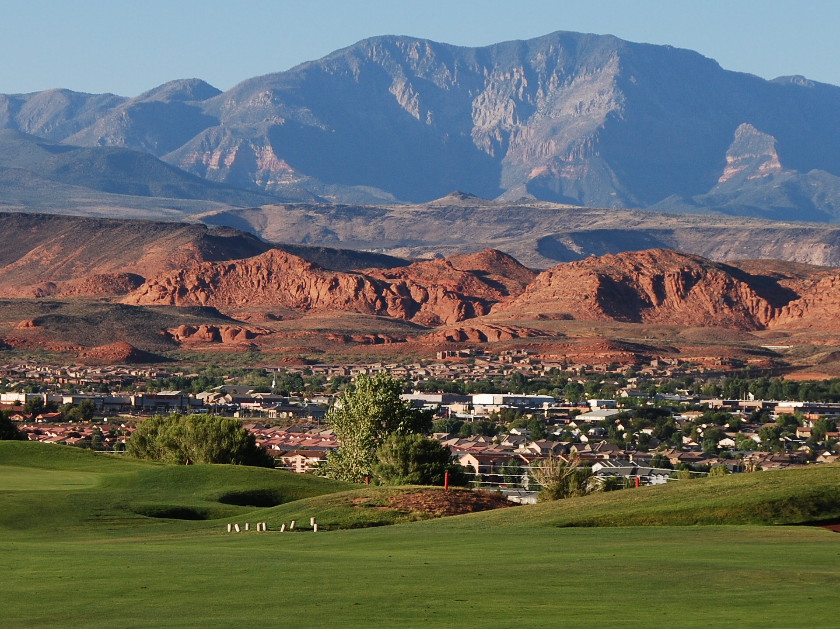
Questions?
Notes:
Taken by Kent Jones

