Slide 1
City Creek
Subdivision
(Area 57, Book 9)
List of Unclaimed Rights
Public Meeting
September 6th, 2017
Utah Division of Water Rights
Mike Handy, P.G.
Adjudication Team Leader
www.waterrights.utah.gov
Notes:
Introduction

Slide 2
Agenda
Adjudication Process Review
List of Unclaimed Rights Overview
Accessing the List of Unclaimed Rights
Anticipated Timeline
Questions

Slide 3
The Adjudication Process
1
2
NOTICE
3
SUMMONS
PETITION
Sep. 1, 1944
Feb. 12, 2017
Mar. 1, 2017
4
5
6
7
90 DAYS TO FILE OBJECTION
PUBLIC MEETING
NOTICE TO FILE
CLAIMS WITHIN 90 DAYS
LIST OF
UNCLAIMED RIGHTS
UNCLAIMED RIGHTS
In Progress
90
90
The Adjudication Process
Mar. 15, 2017
Mar. 31, 2017
Aug. 25, 2017
8
9
10
11
PUBLIC MEETING
OBJECTION
RESOLUTION & DECREE
CLAIM INVESTIGATION
PROPOSED DETERMINATION
In Progress
In Progress
W.U.C.
W.U.C.
P.D.
12
13
14
15
90 DAYS TO FILE OBJECTION
PUBLIC MEETING
FINAL SUMMONS
OBJECTION RESOLUTION & DECREE
90

Slide 4
List of Unclaimed Rights
Contents
Title Page
Notice to Water Users
Preamble
Location Map
Unclaimed Rights
Alphabetic Index

Slide 5
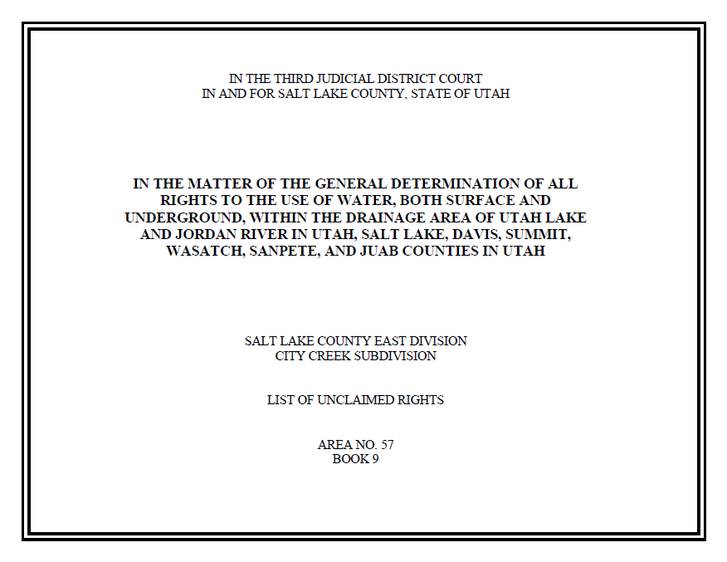
City Creek List of Unclaimed Rights
Title Page
District Court Jurisdiction
General Adjudication Description
Hydrologic Division & Subdivision Names
Area & Book Numbers

Slide 6
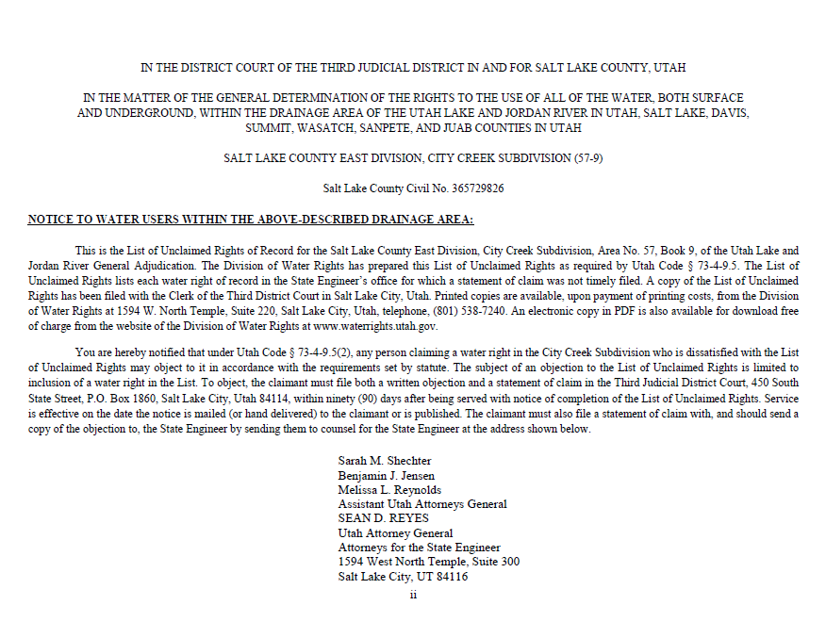
City Creek List of Unclaimed Rights
Notice to Water Users
Civil Case Number
Instructions on filing an objection

Slide 7
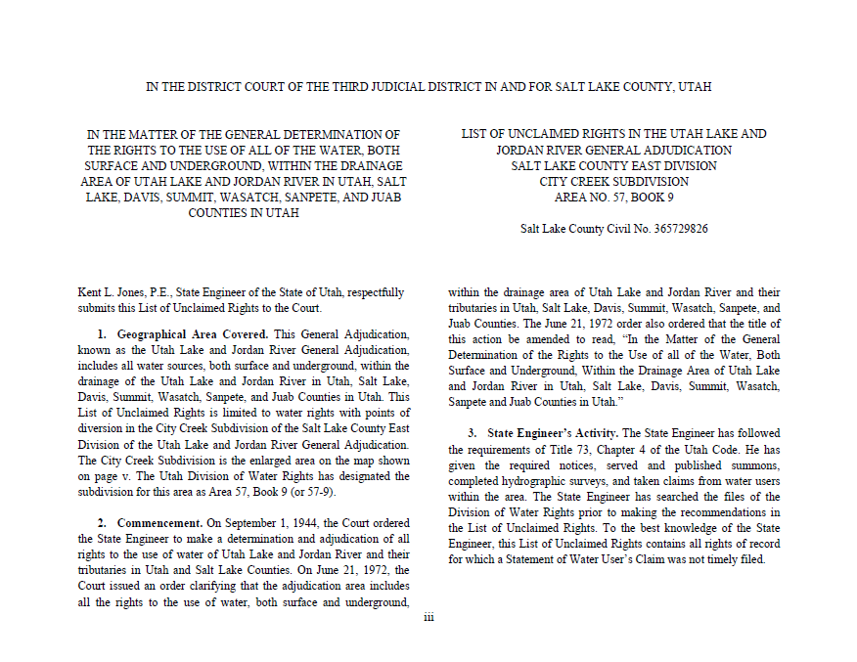
City Creek List of Unclaimed Rights
Preamble
What is contained within this List of Unclaimed Rights

Slide 8
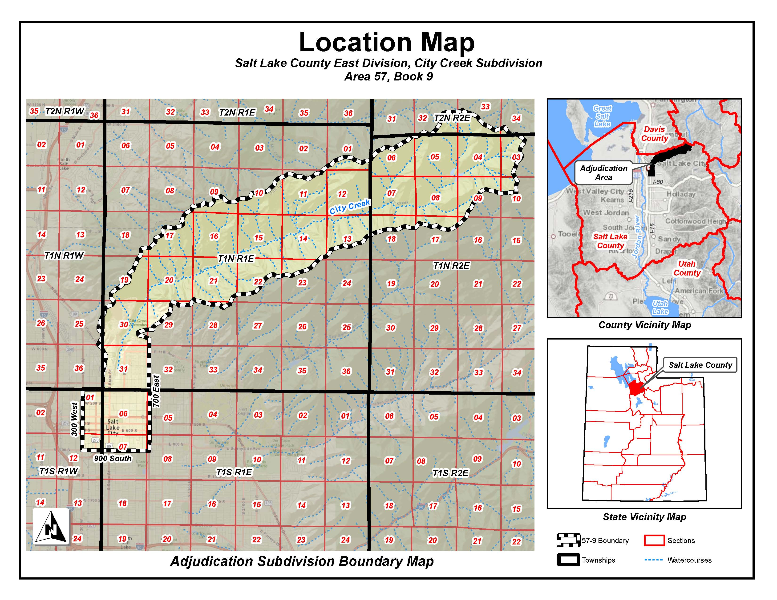
City Creek List of Unclaimed Rights
Location Map
Watershed
Boundary
300 West
700 East
900 South

Slide 9
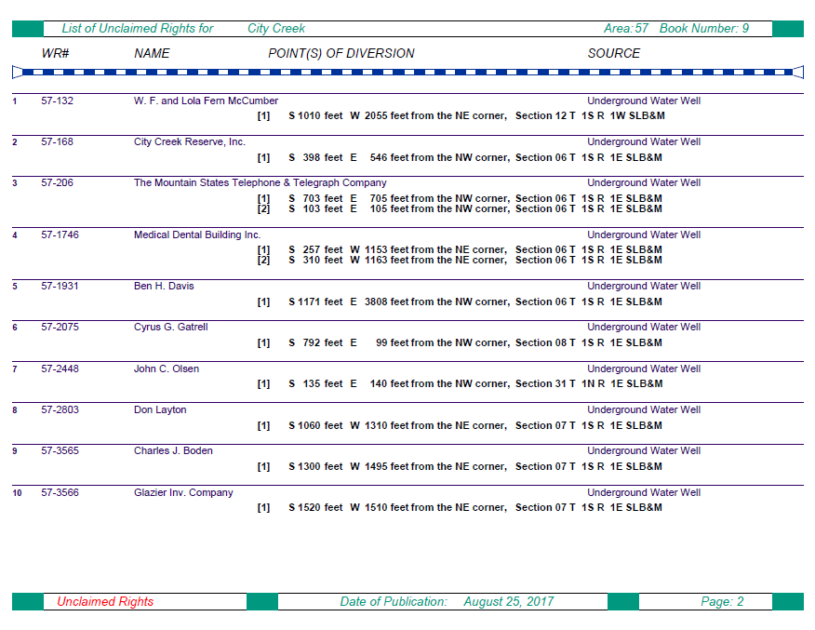
City Creek List of Unclaimed Rights
Unclaimed Rights
Water Right Number
Name of Owner of Record
Point of Diversion Location and Source

Slide 10
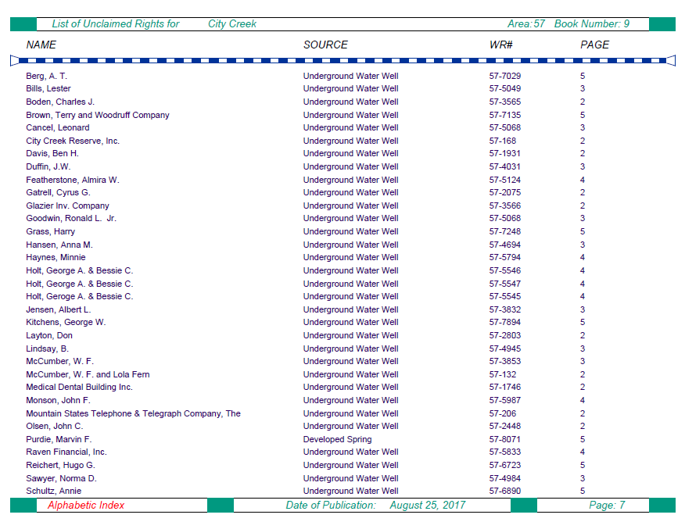
City Creek List of Unclaimed Rights
Alphabetic Index
Page
Number
Water Right Number
Name of Owner of Record
Point of Diversion Source

Slide 11
Accessing the List of Unclaimed Rights
Recipients of the Notice of the List of Unclaimed Rights:
Water right owners listed on the records of the State Engineer.
Property owners within the City Creek adjudication area.
Registered agents for corporate entities within the adjudication boundary.
Counsel of record who have filed an appearance in the court.
The List of Unclaimed Rights can be accessed via:
http://www.waterrights.utah.gov/pdbooks/CityCreekLUR
Hardcopies can be printed at our office for a nominal fee.
Filed at the District Court.

Slide 12
Anticipated Timeline
August 25, 2017:
State Engineer publishes the List of Unclaimed Rights.
90-day objection period begins.
State Engineer holds a public meeting (September 6, 2017).
November 23, 2017:
90-day objection period for List of Unclaimed Rights ends.
April 2018:
State Engineer publishes the Proposed Determination.
90-day objection period begins.
State Engineer holds a public meeting.
July 2018:
90-day objection period for Proposed Determination ends.

Slide 13
Who can I contact to discuss the
Adjudication Process?
Blake Bingham, P.E.
Assistant State Engineer - Adjudication
E-mail: blakebingham@utah.gov
Gary Brimley, P.E.
Adjudication Engineer
E-mail: garybrimley@utah.gov
Mike Handy, P.G.
Adjudication Team Leader
Phone: 801-538-7463
E-mail: mikehandy@utah.gov
Utah Division of Water Rights
1594 West North Temple
Suite 220, PO Box 146300
Salt Lake City, UT 84114-6300
www.waterrights.utah.gov

Slide 14
Questions?

